Slide 1
ONLINE FOOD ORDERING SYSTEM
GROUP NO. 16
18BCA086 – SOURAV AGRAWAL
18BCA088 – SAHIL MANSURI
18BCA132 – DIVYANSH JAIN
Internal Guide : Ms. Manali Brahmbhatt
External Guide :Mr. Jugal Prajapati

Slide 2
INDEX
About Company
Company Details
Project Description
Requirement Gathering
Tools and Technologies Used
Screen Layouts
Database Snips
Reports

Slide 3
About Company
Aarnik Technology, as a website development company, holds a repu-ted image among its competition.
Company believes on developing completely unique and outstanding websites.
Aarnik Technology has always assured the best services to its clients as it has professionals working for its clients.
It excels in fields like website development, mobile app development, digital marketing, and ERP software development.

Slide 4

Company Details
Company Name : Aarnik Technology
Address : K8 Krishna Centre, Navrangpura, Ahmedabad 380009
Email Address : info@aarniktechnology.com
Contact Number : 9586248516

Slide 5
About Project
The Online Food Ordering System is a food ordering website. It
provides convenience to the customers by providing online ordering
system and overcomes disadvantages of the traditional
queuing systems.
It gives restaurants the ability to increase their sales and expand
their business.
With Online Food Ordering system, we can setup restaurant menu
online and customers can also track their orders with few simple
steps.

Slide 6
Requirement Gathering
What we have come up with is, an online food ordering system which is
completely web-based. This system can be a proven solution in today’s
modern world where people live a busy life.
In this system, admin can view users that are registered on the website, the admin can also manage feedbacks, payment details and can generate reports too.
The restaurants can manage food items, accept orders, create menu categories, they can accept payments using the website
Today inflation rates are increasing rapidly, so in such time to have a
fine dining experience at the restaurant is not feasible for everyone.
This way people can have their favourite food delivered at their home.

Slide 7




Tools and Technologies Used
Frontend : Python Django v3.1
Backend : MySQL v5.6
Other Tools: Edraw Max 9.0,
Microsoft PowerPoint 2010

Slide 8
Screen Layouts

Slide 9
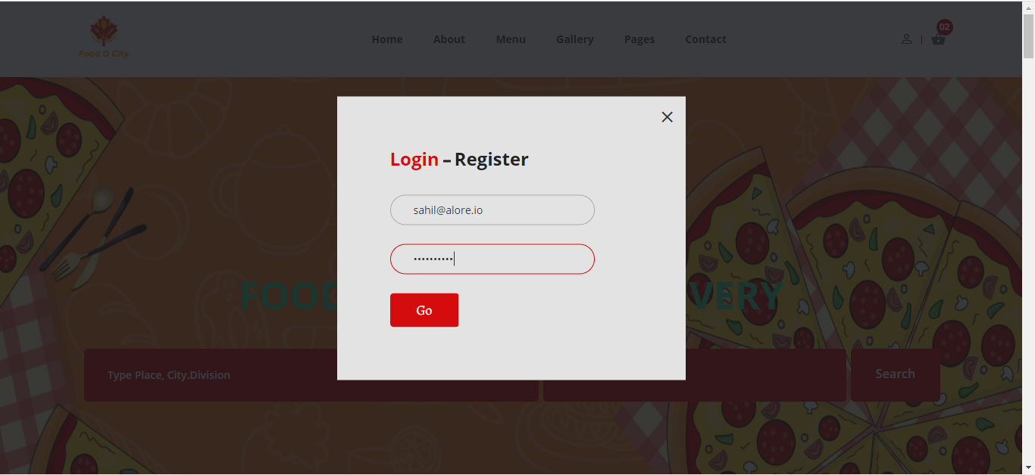
Login Page-Valid

Slide 10
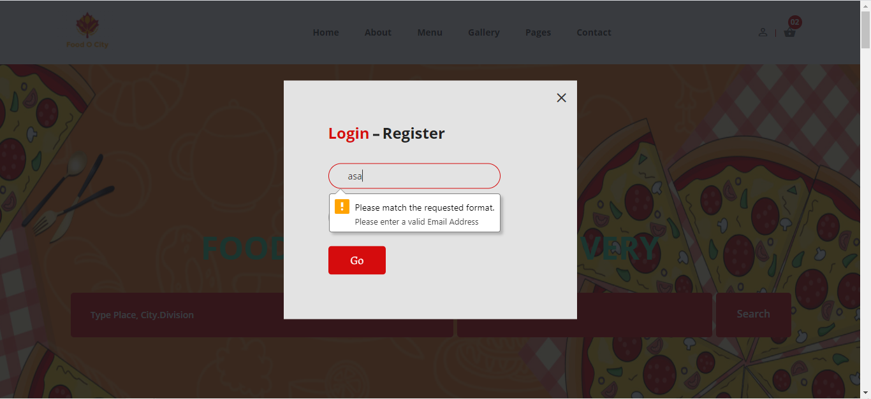
Login Page
Invalid Email

Slide 11
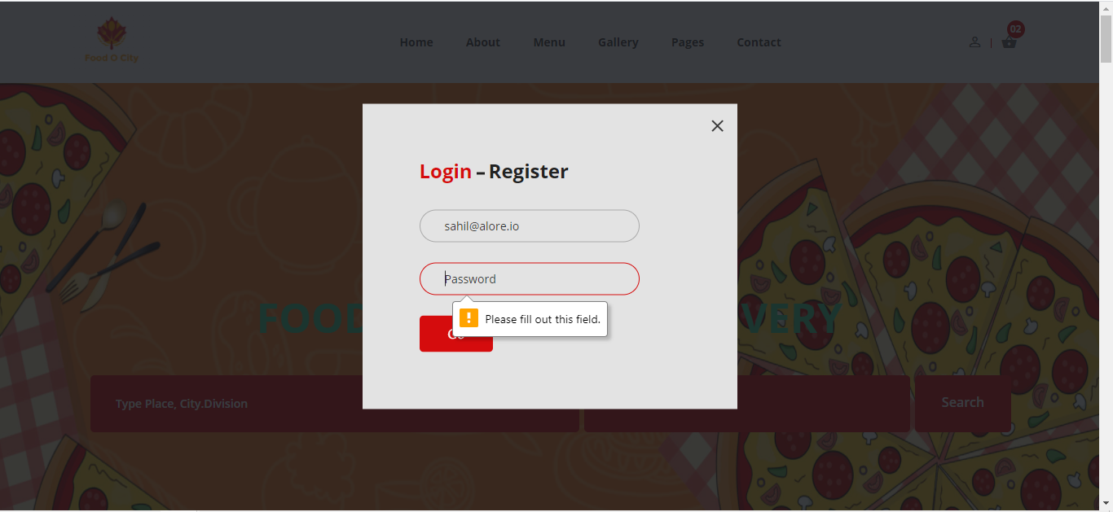
Login Page
Invalid Password

Slide 12
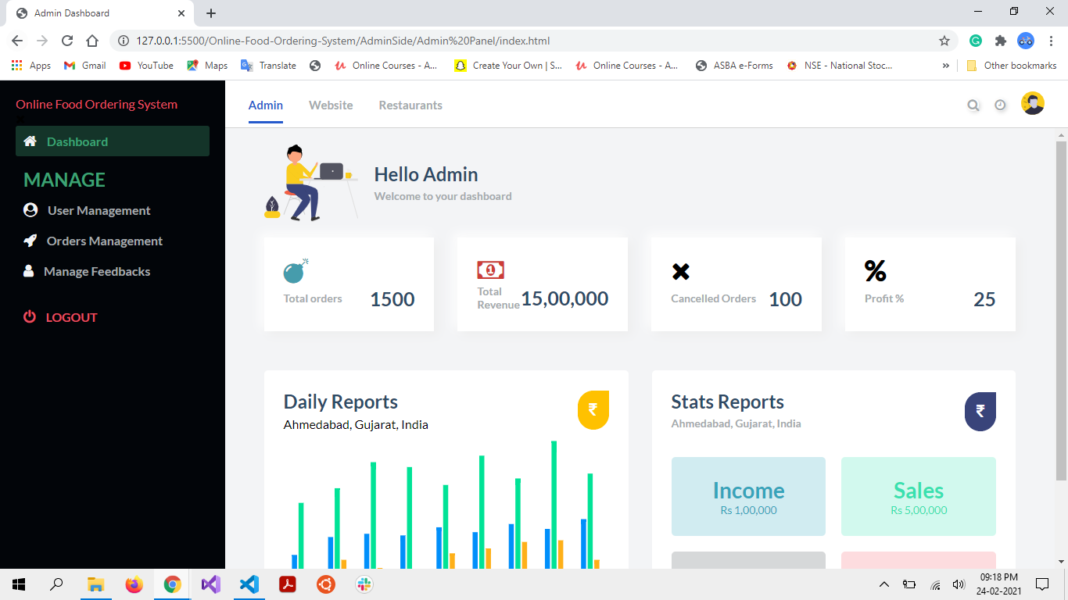
Admin Homepage

Slide 13
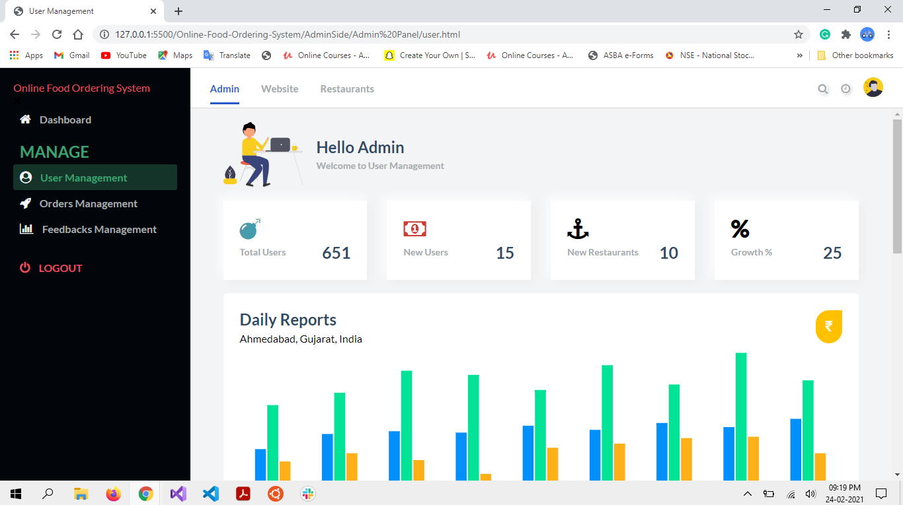
Admin User Management Page-1

Slide 14
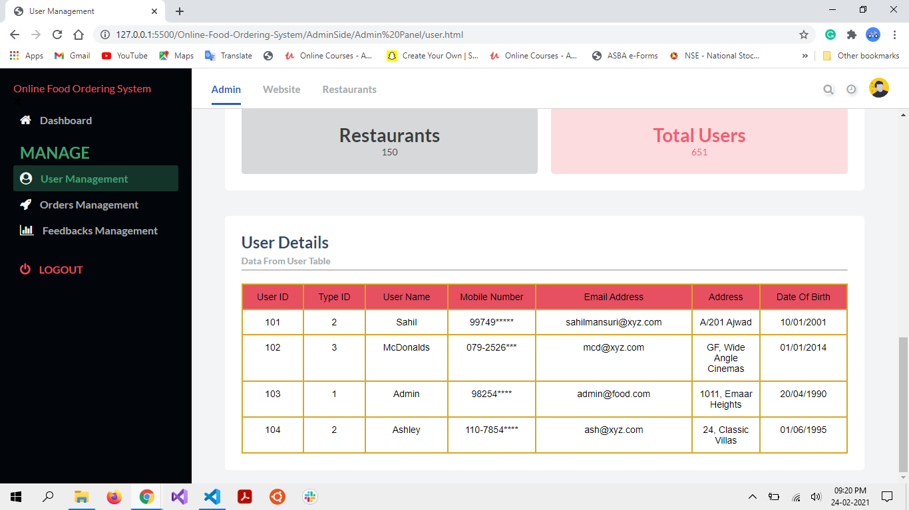
Admin User Management Page-2

Slide 15

Admin Order Management Page-1

Slide 16
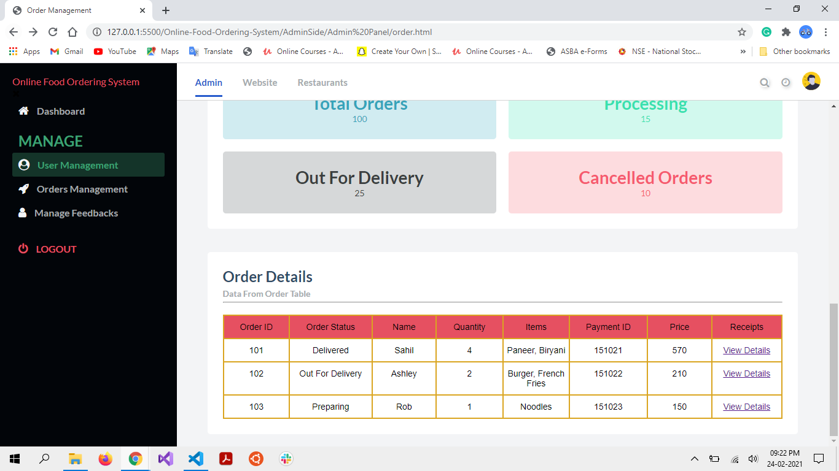
Admin Order Management Page-2

Slide 17
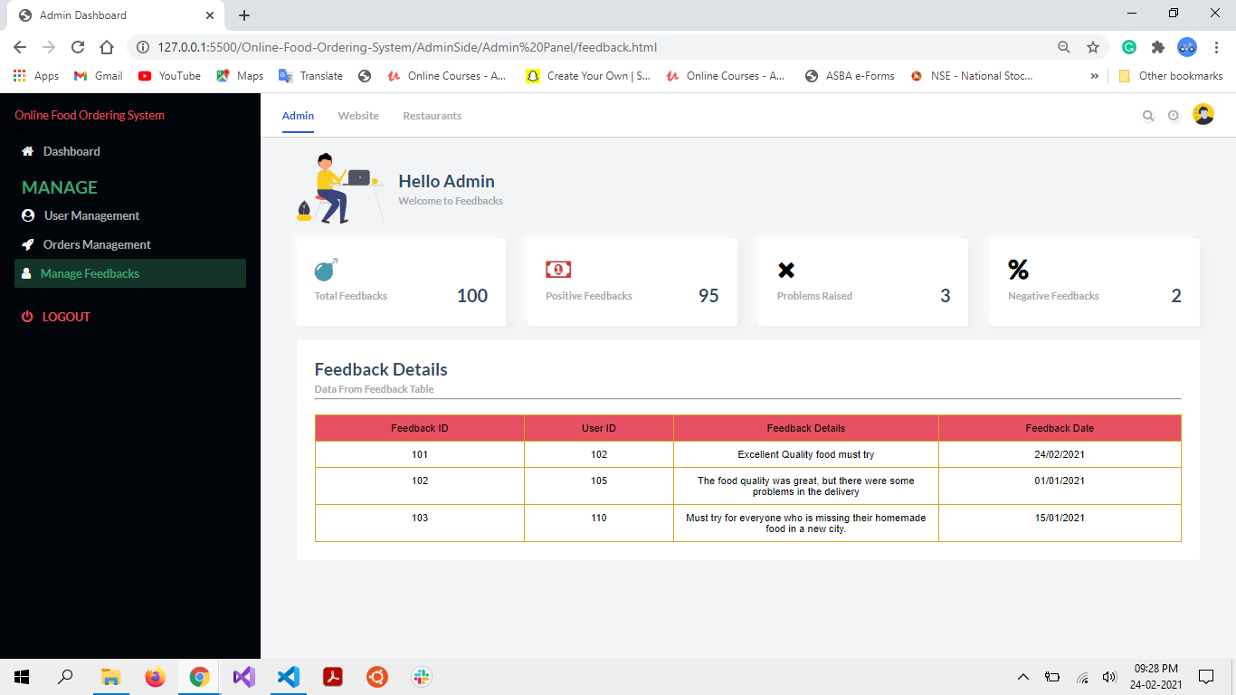
Admin Manage Feedbacks Page

Slide 18
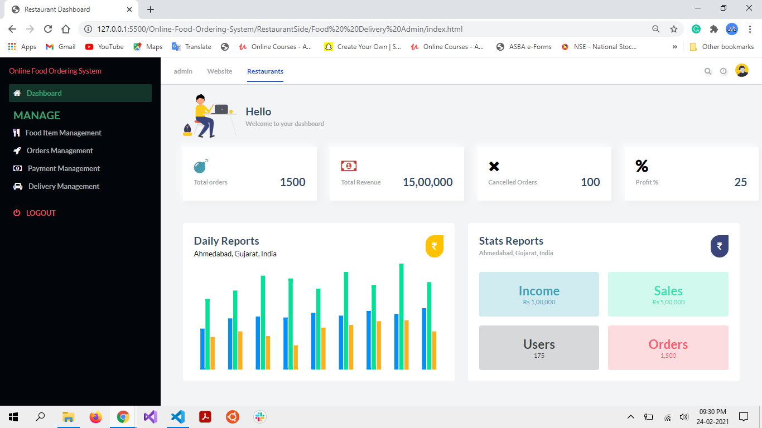
Restaurant Homepage

Slide 19
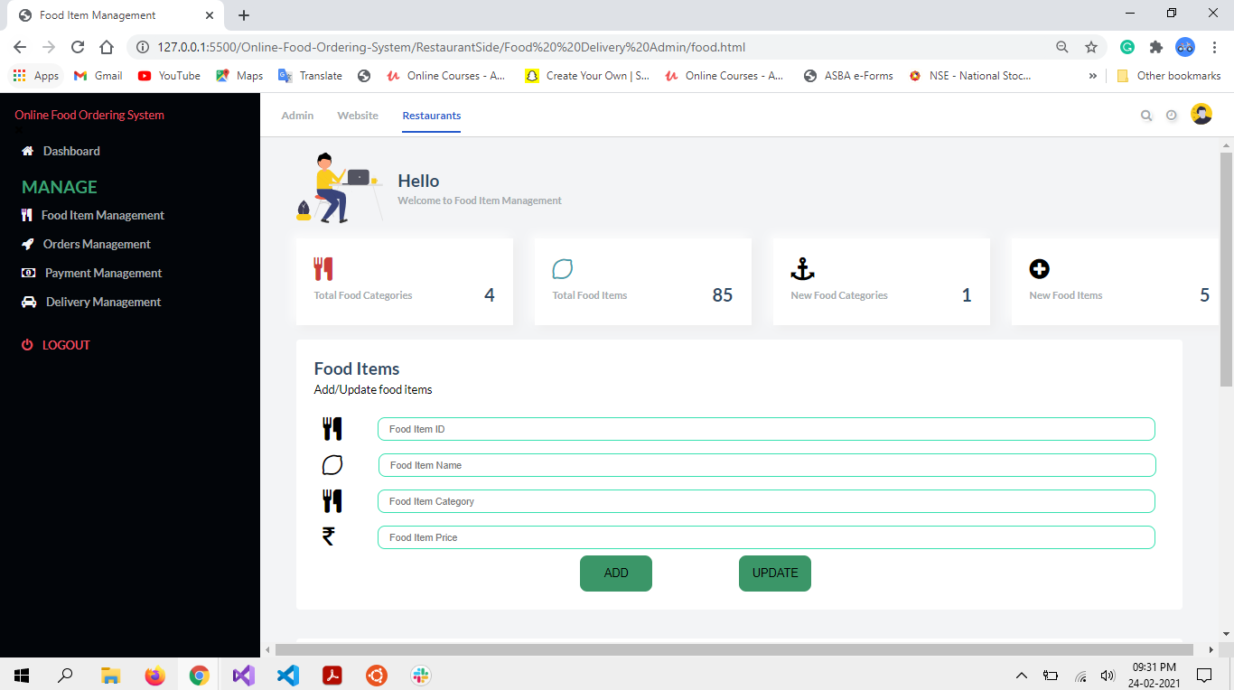
Restaurant Manage Food Items Page-1

Slide 20
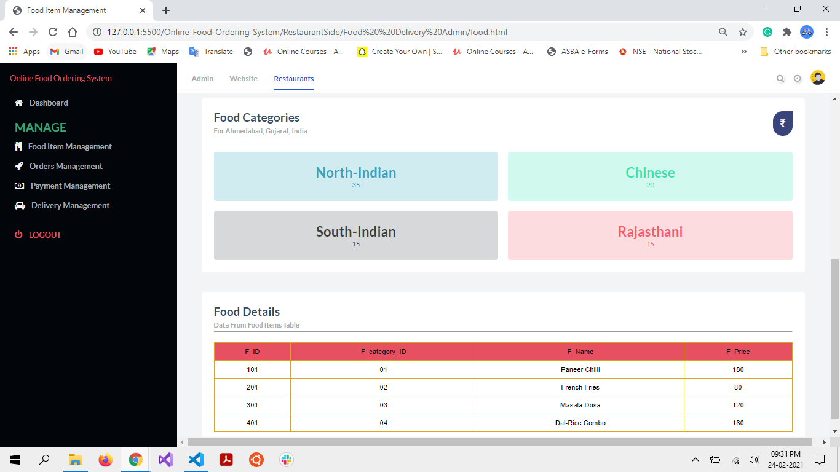
Restaurant Manage Food Items Page-2

Slide 21
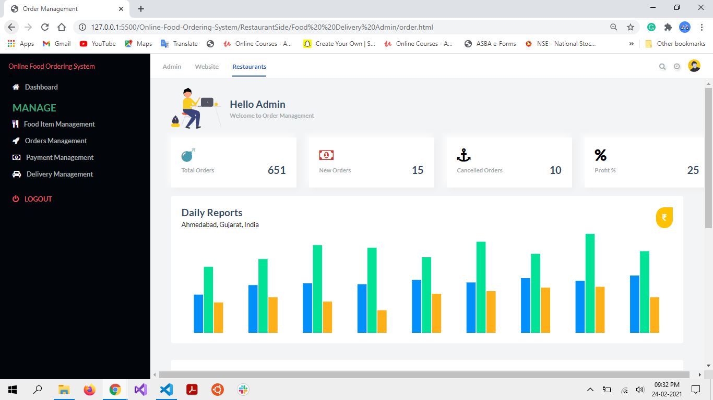
Restaurant Manage Orders Page-1

Slide 22

Restaurant Manage Orders Page-2

Slide 23
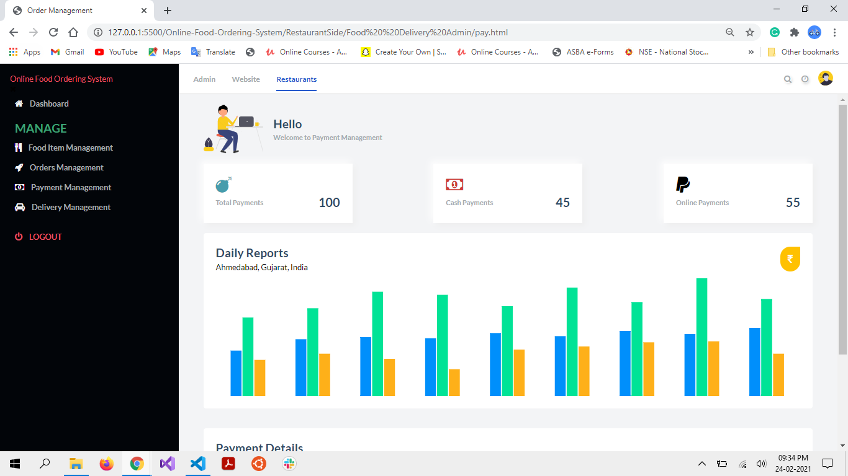
Restaurant Manage Payments Page-1

Slide 24
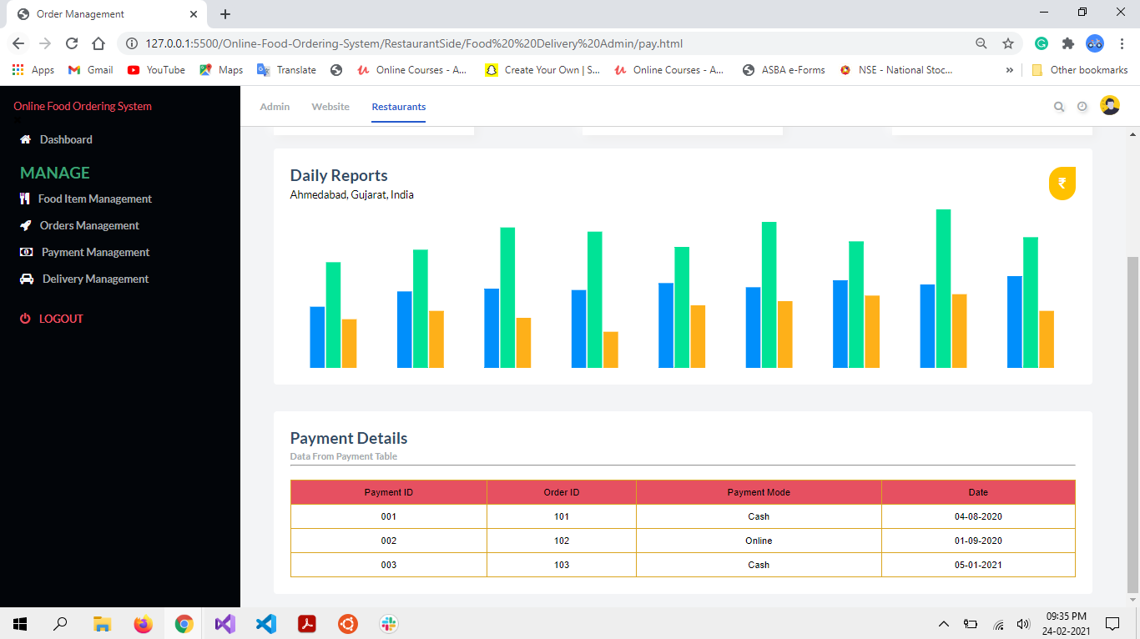
Restaurant Manage Payments Page-2

Slide 25
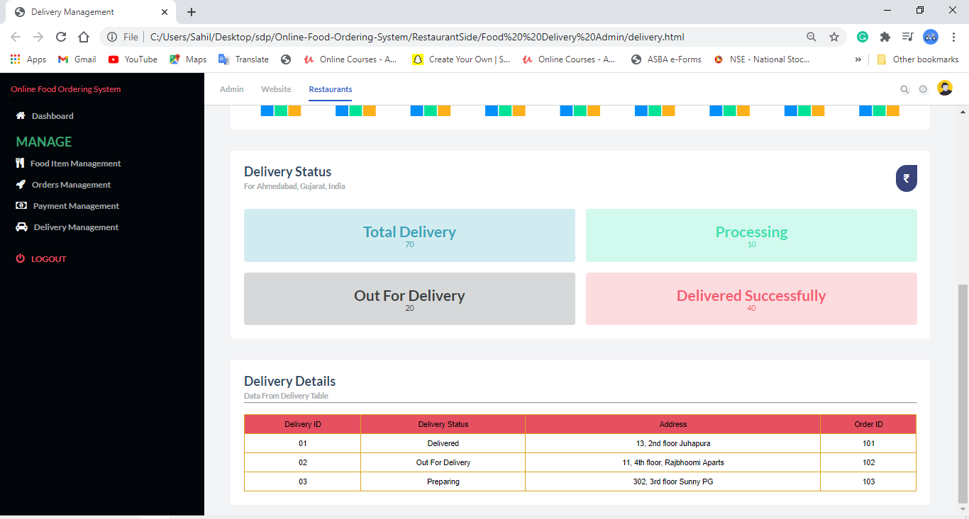
Restaurant Manage Deliveries Page

Slide 26
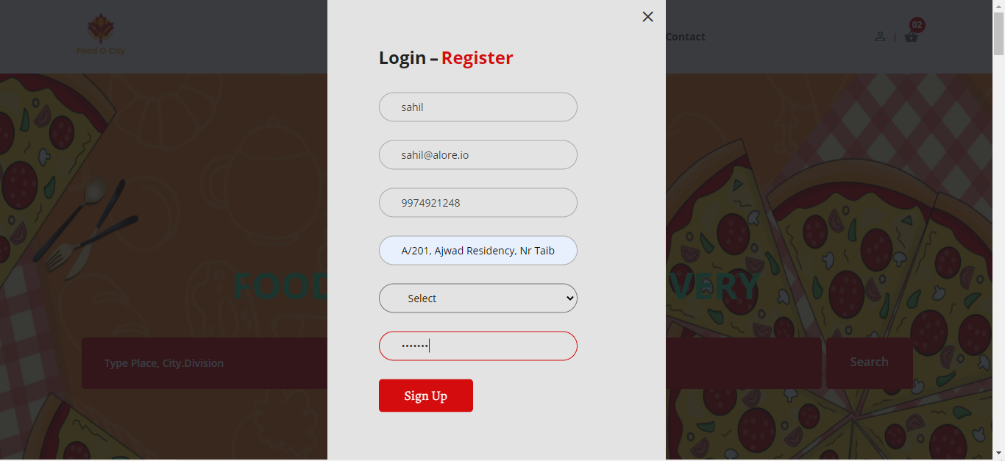
User Registration Page - Valid

Slide 27
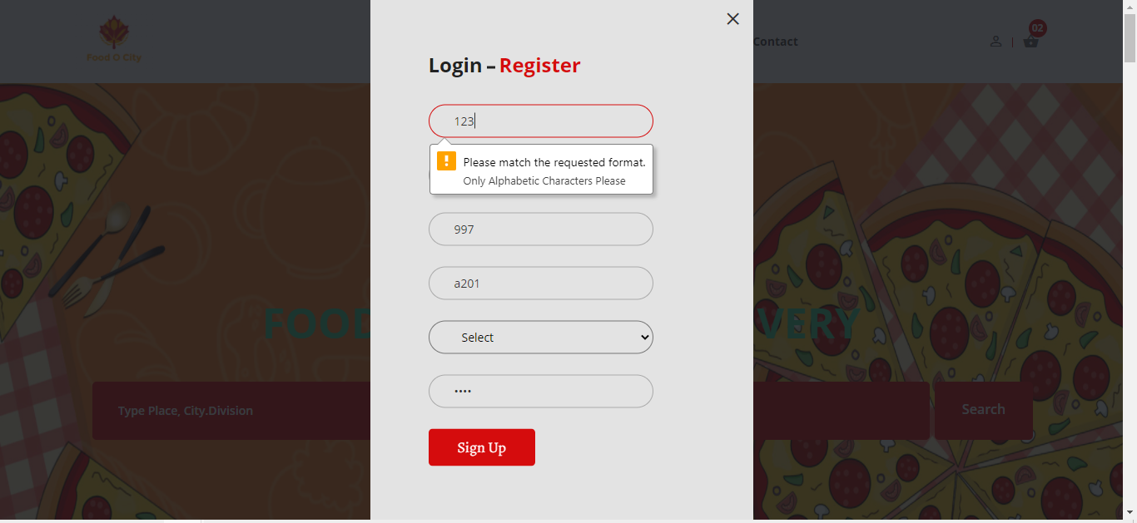
User Registration Page – Invalid User Name

Slide 28
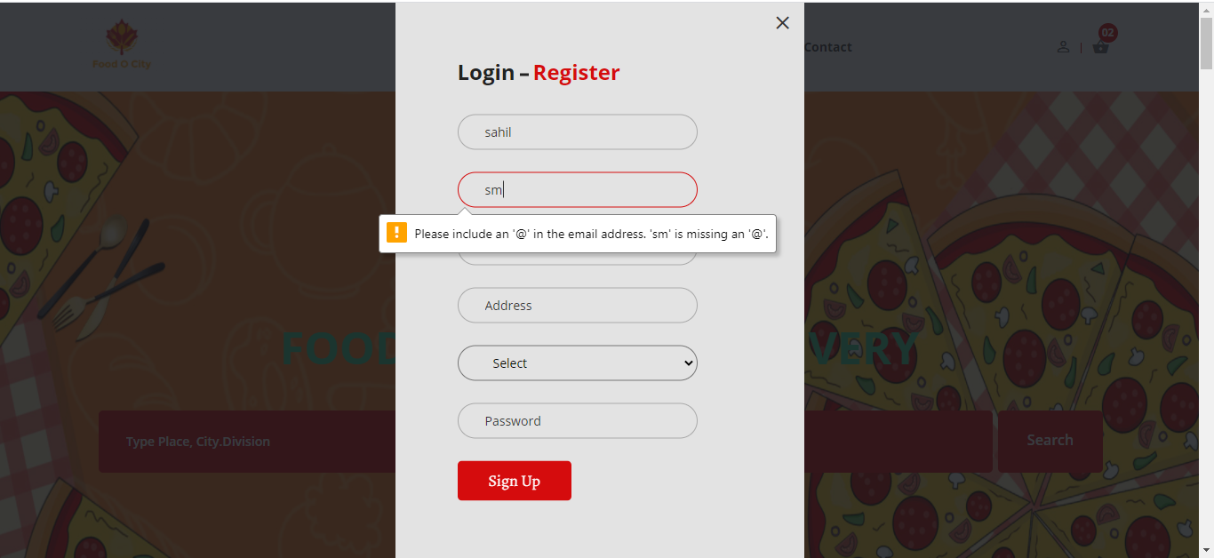
User Registration Page – Invalid email

Slide 29
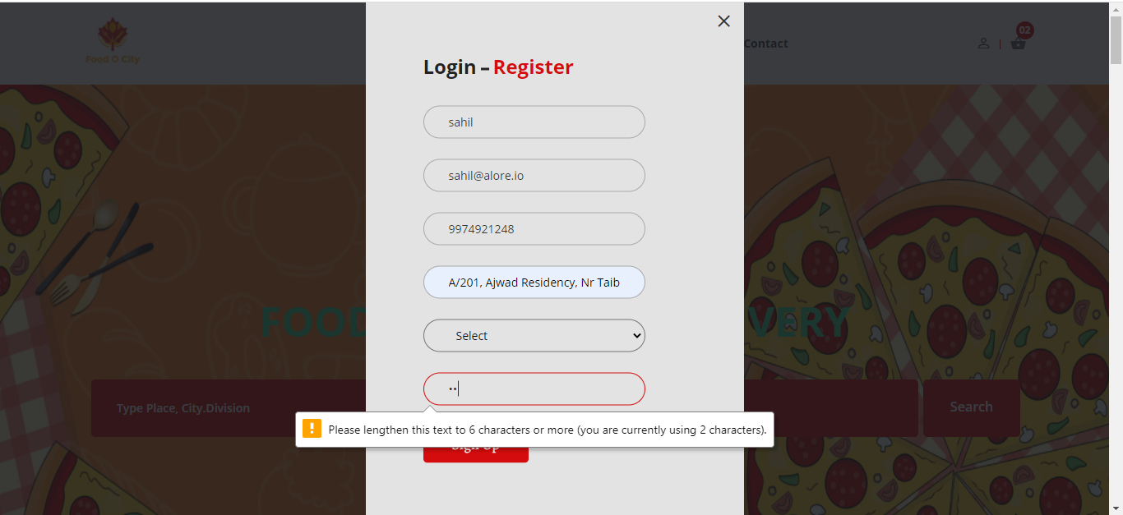
User Registration Page – Invalid Password

Slide 30
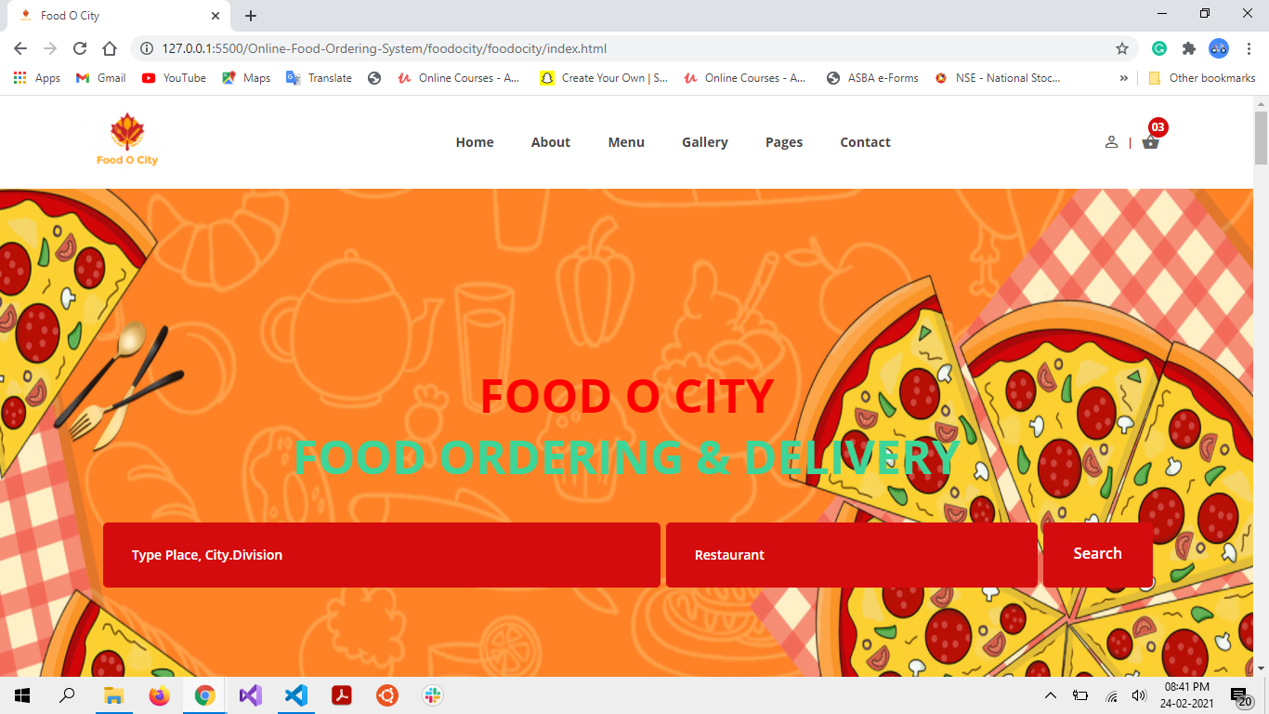
Home Page

Slide 31
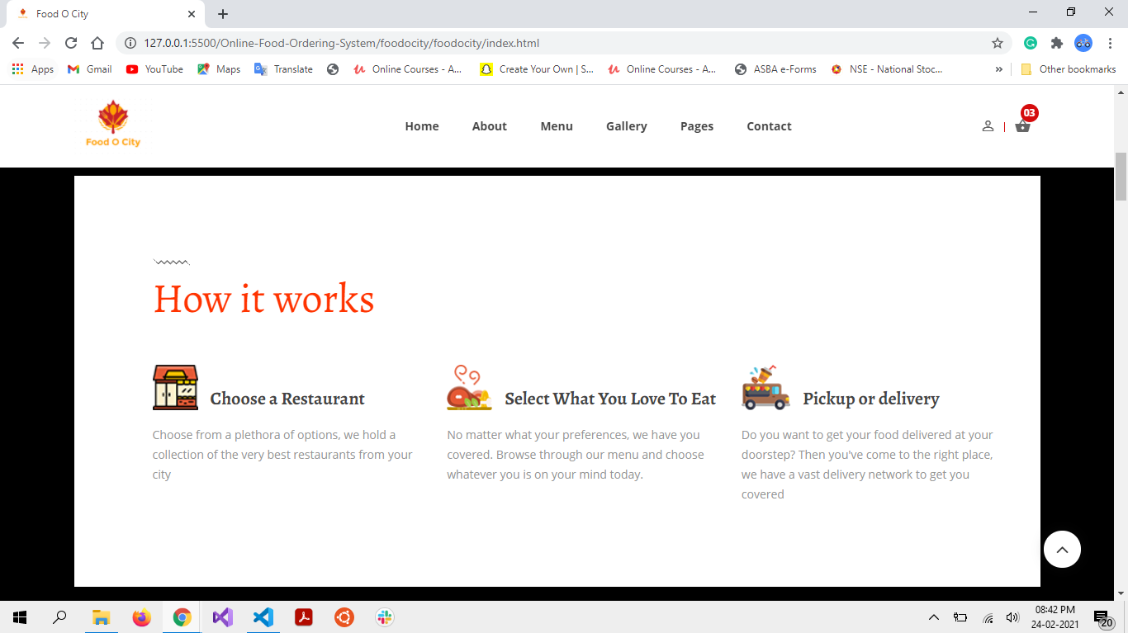
Home Page 2

Slide 32
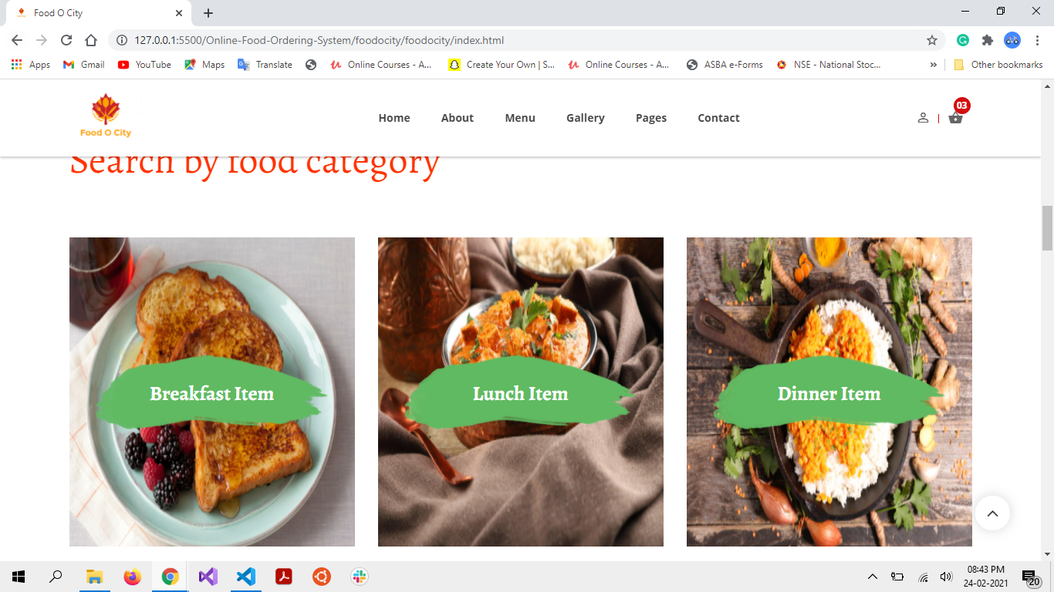
Home Page 3

Slide 33
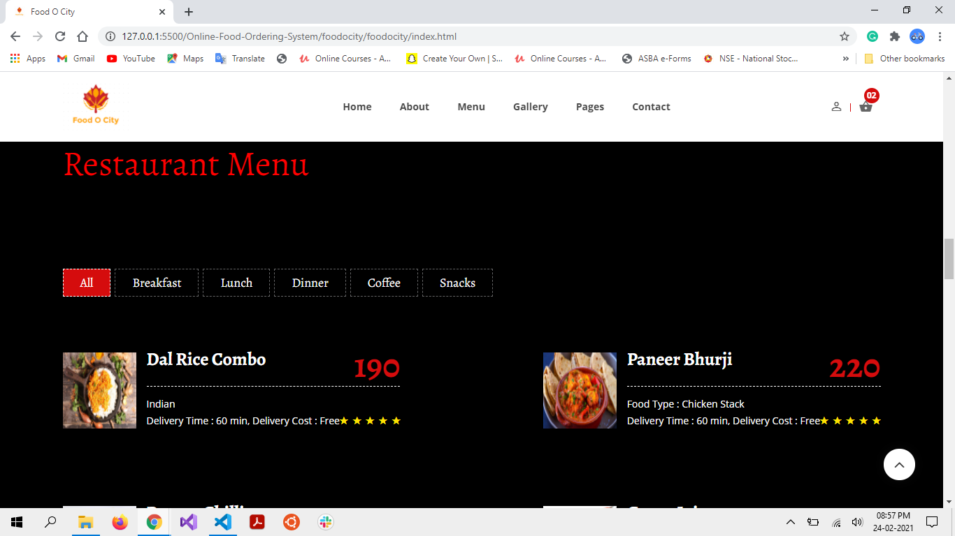
Home Page 4

Slide 34
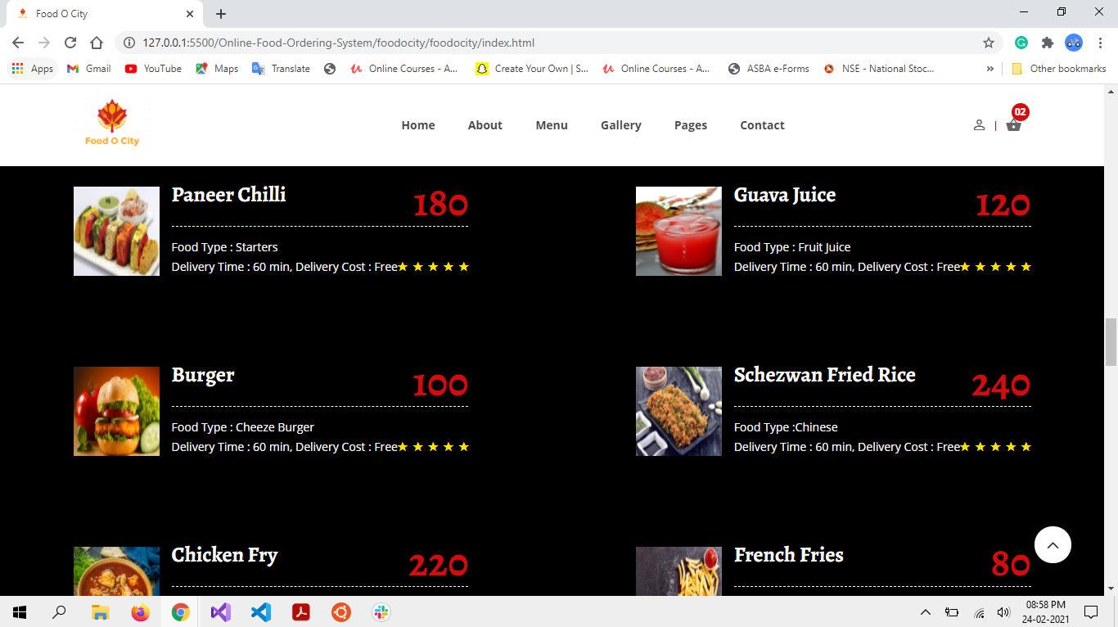
Home Page 5

Slide 35
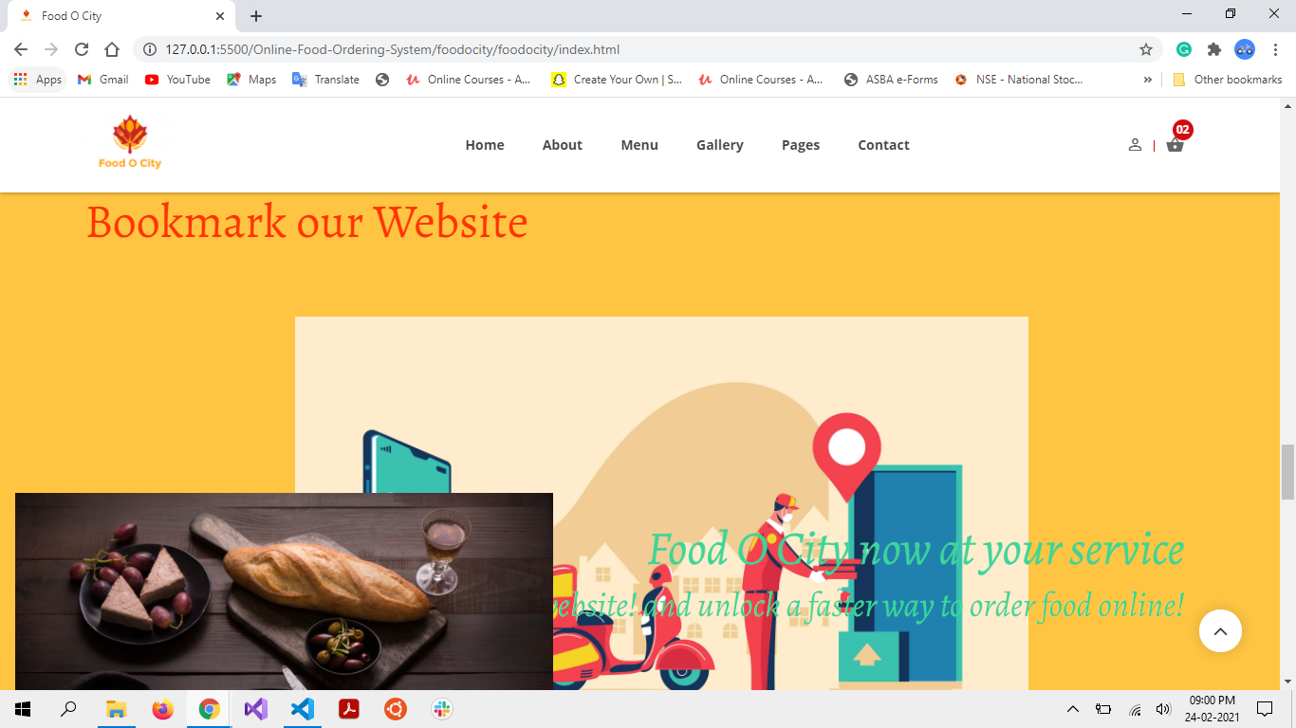
Home Page 6

Slide 36
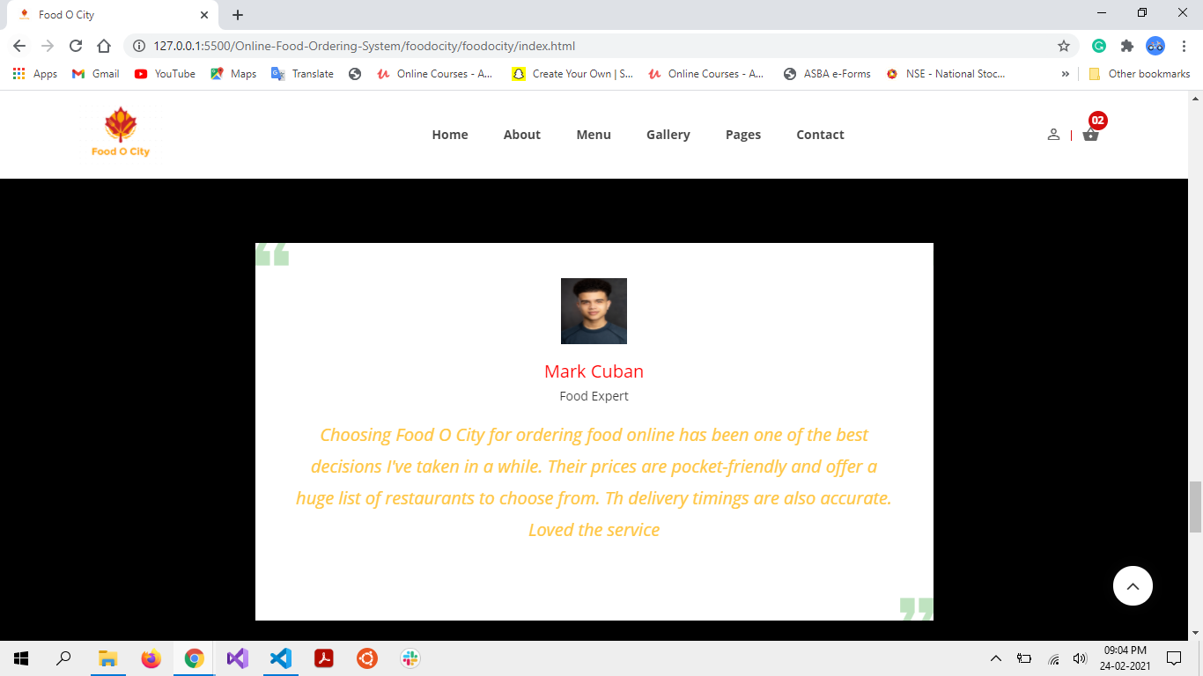
Home Page 7

Slide 37
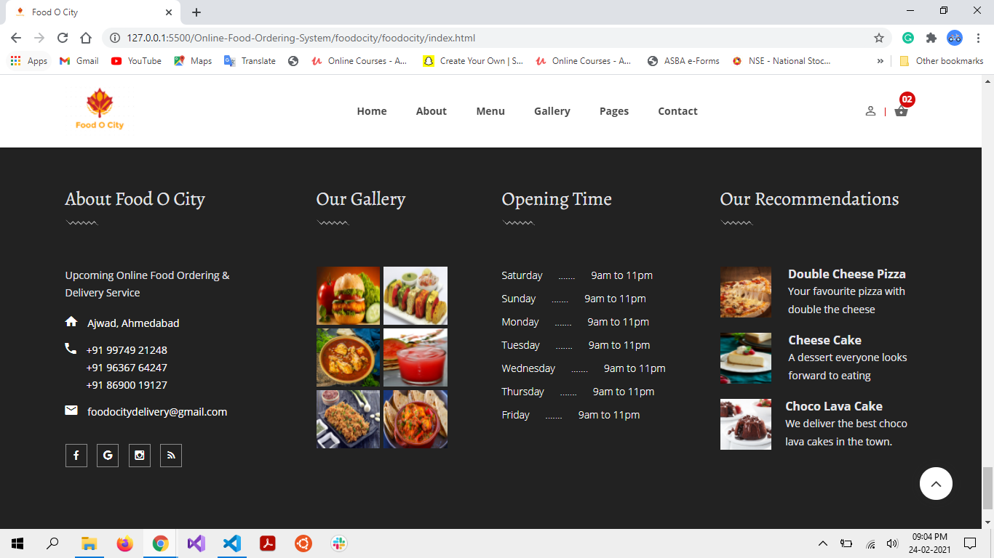
Home Page 8

Slide 38
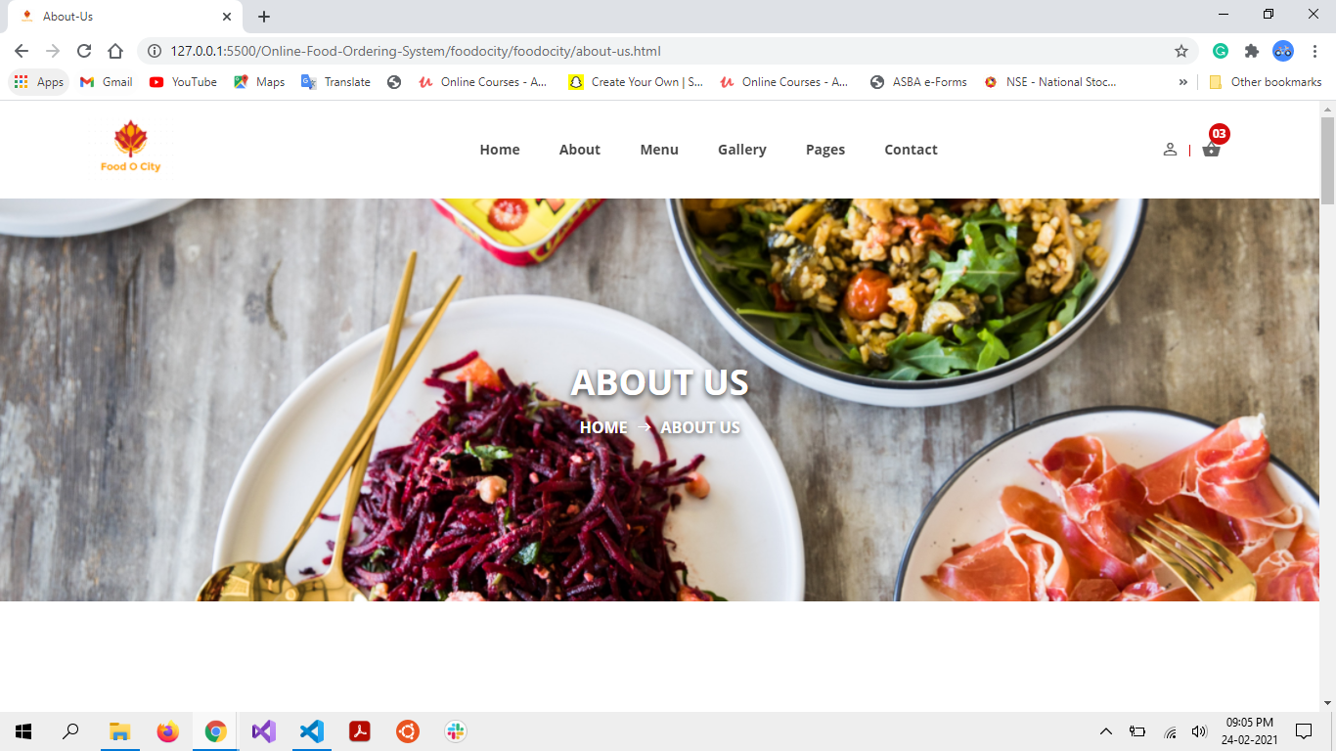
About Page 1

Slide 39
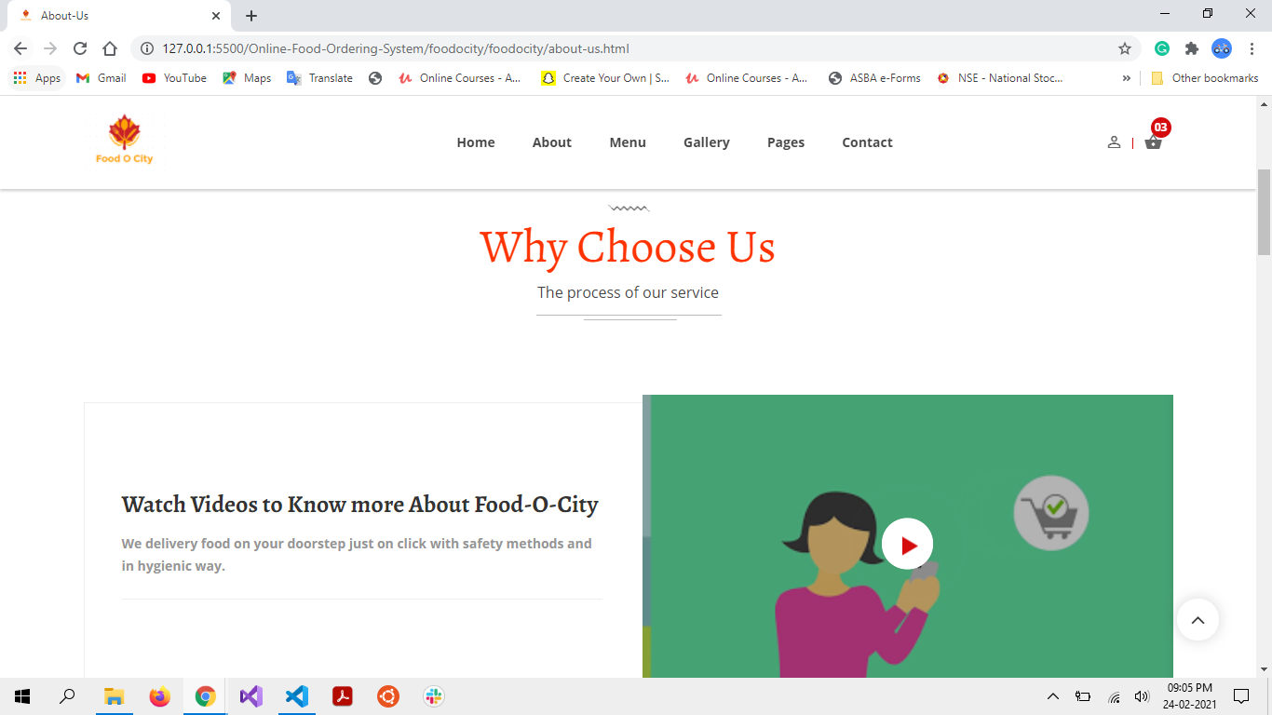
About Page 2

Slide 40
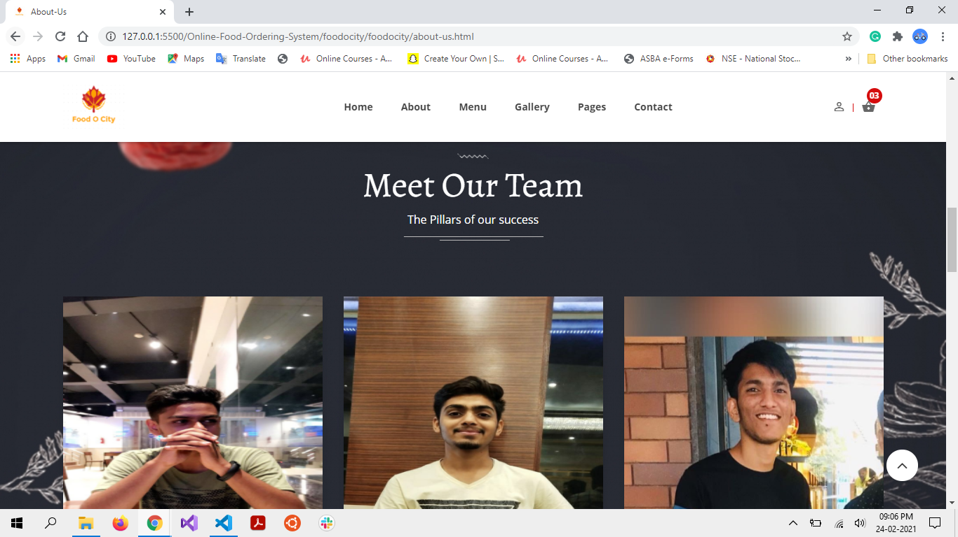
About Page 3

Slide 41
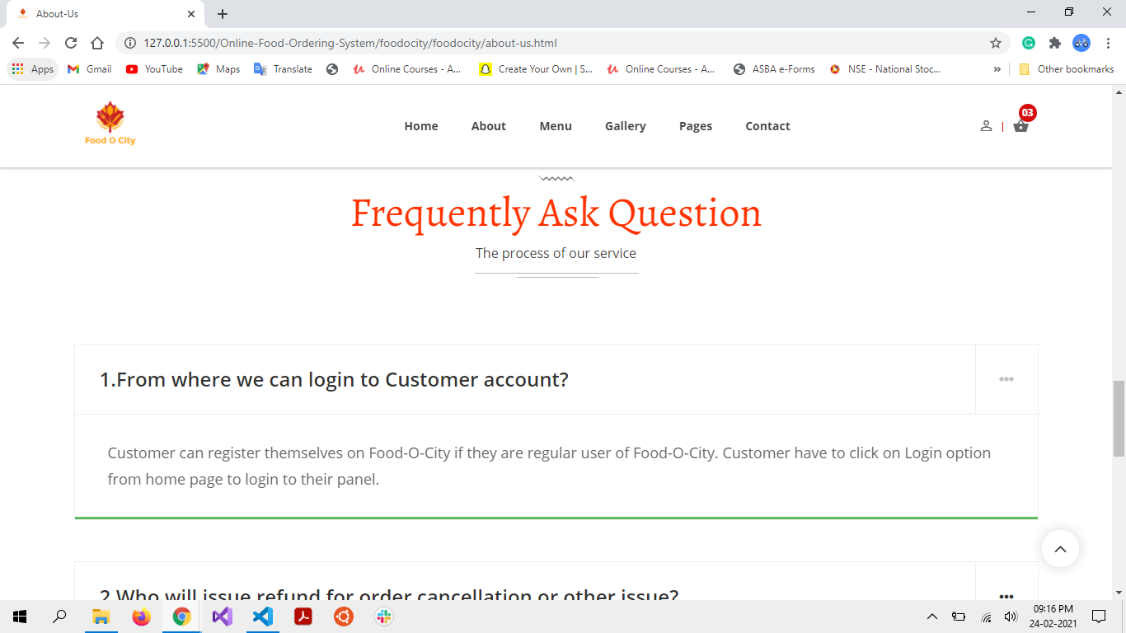
About Page 4

Slide 42
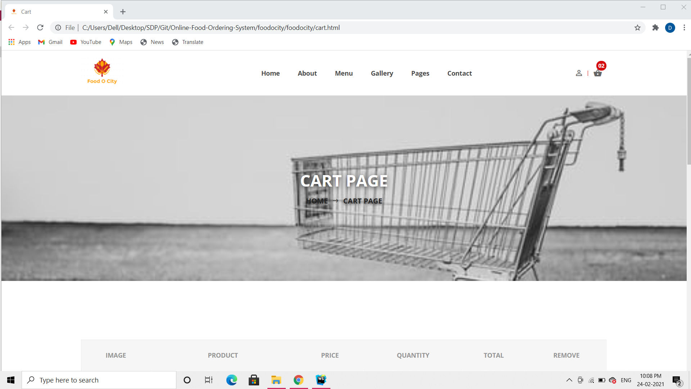
Cart Page 1

Slide 43
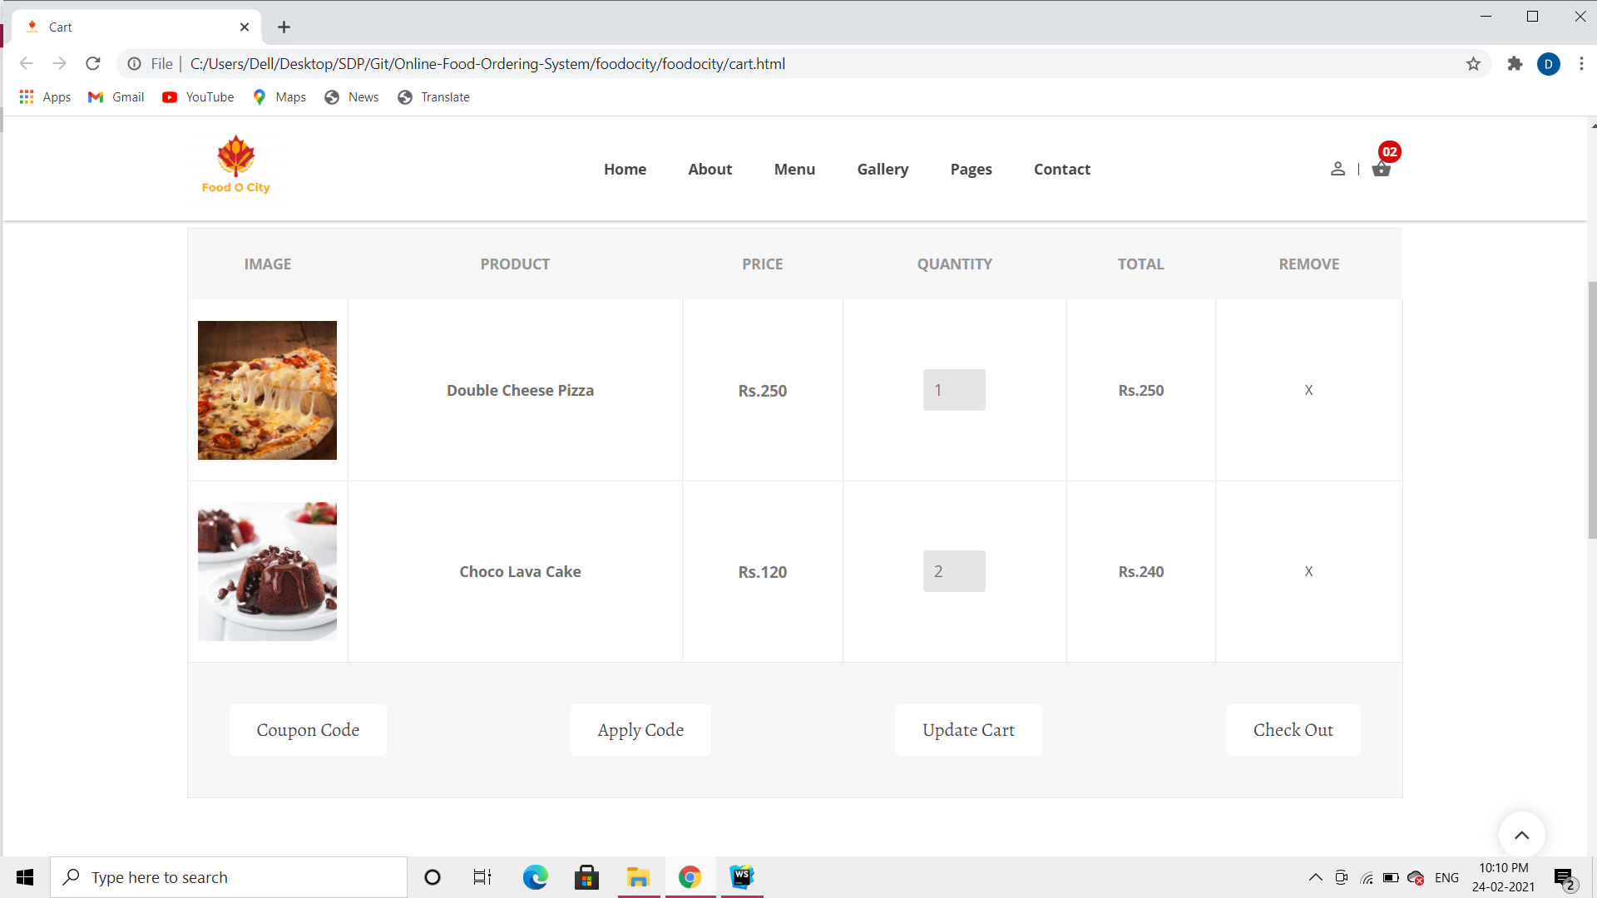
Cart Page 2

Slide 44
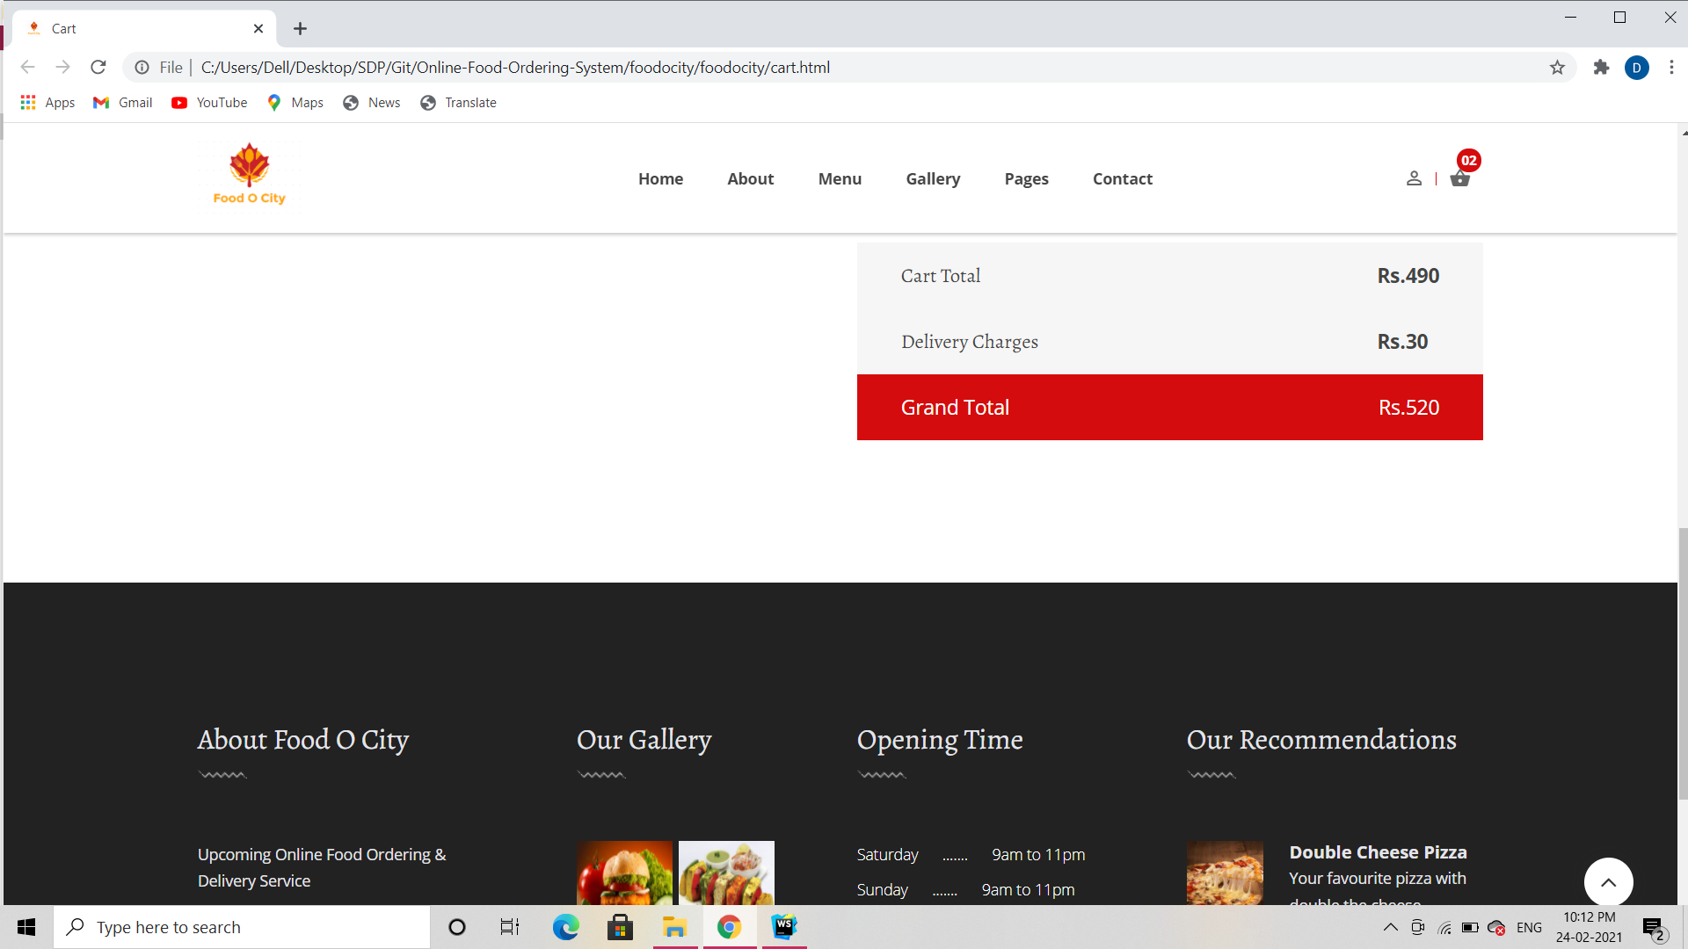
Cart Page 3

Slide 45
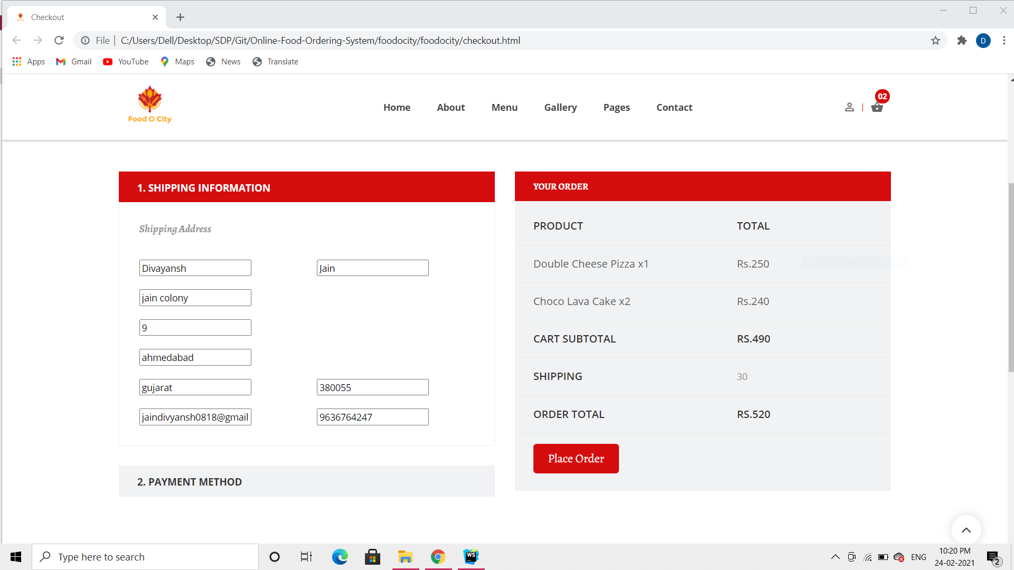
Checkout Page 1

Slide 46
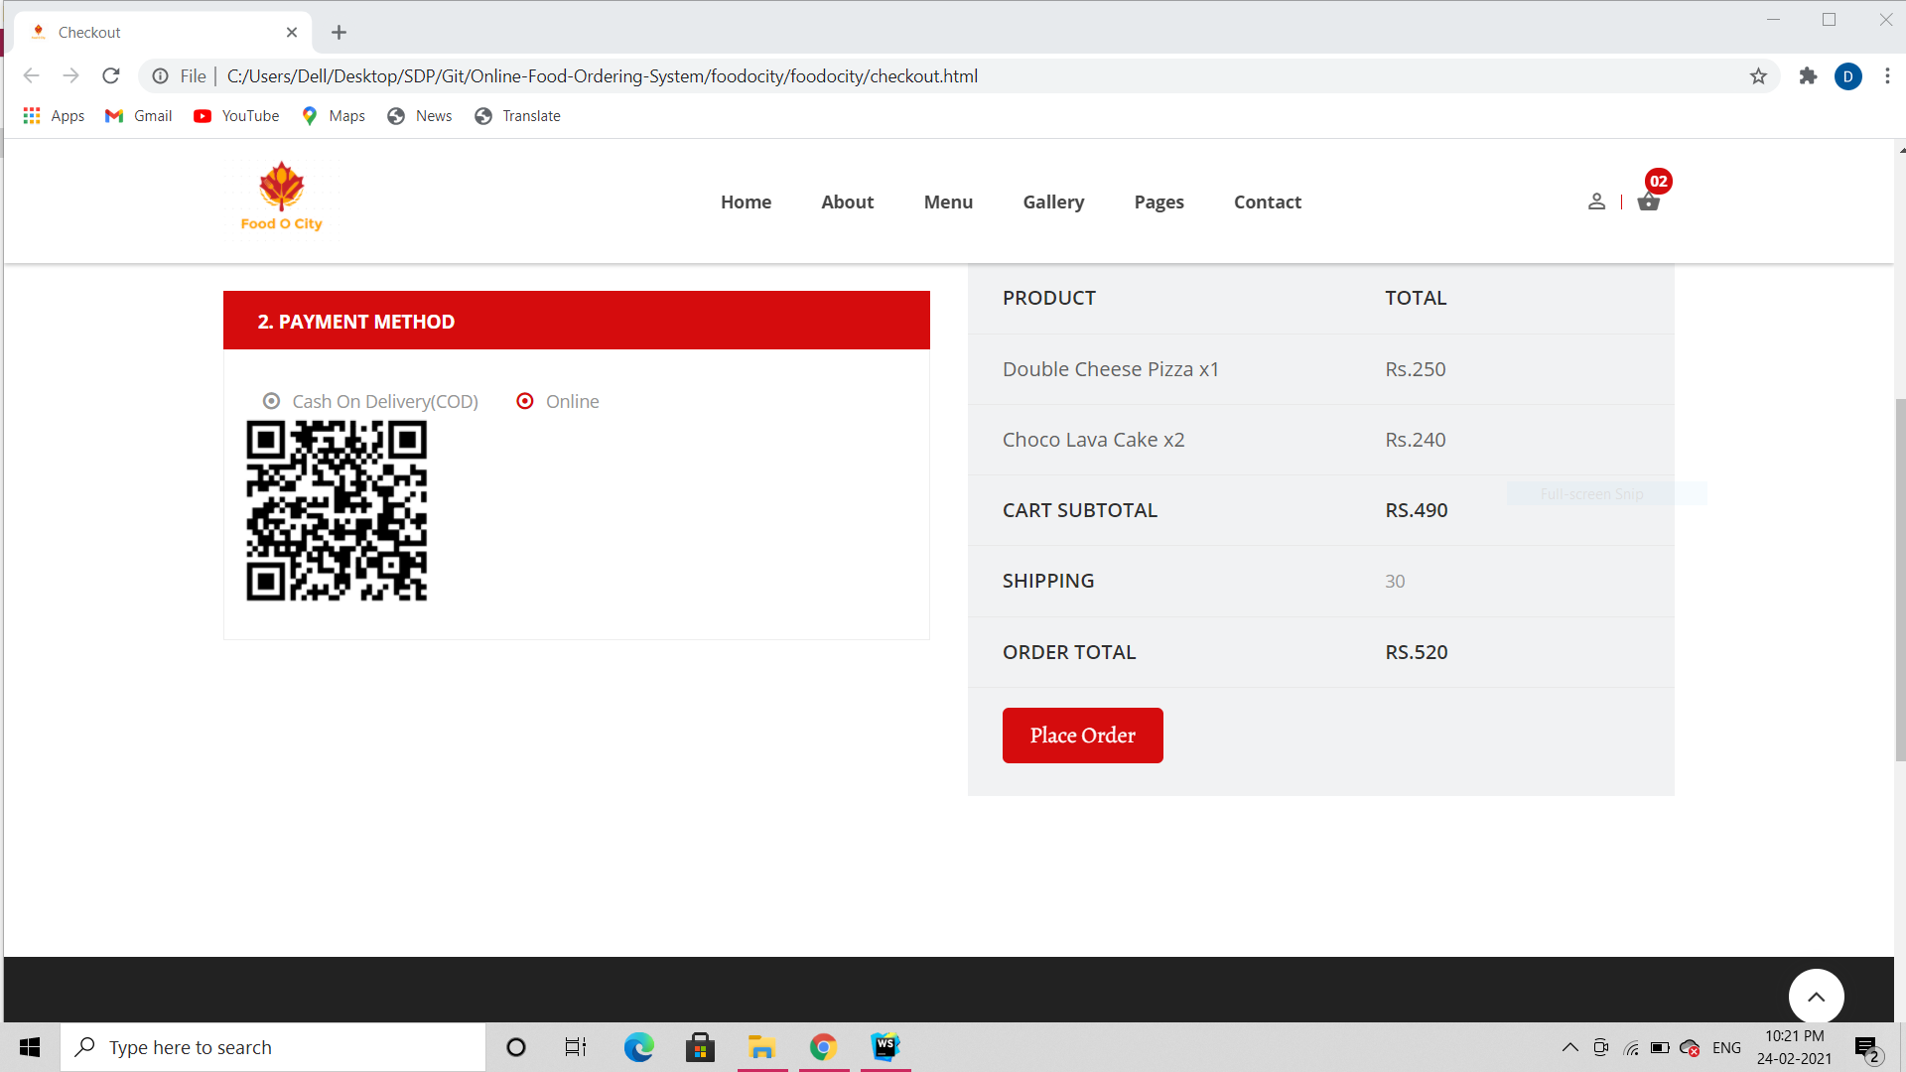
Checkout Page 2

Slide 47
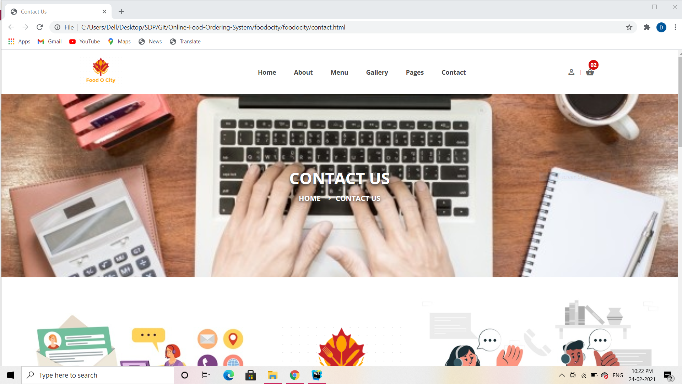
Contact Us Page 1

Slide 48
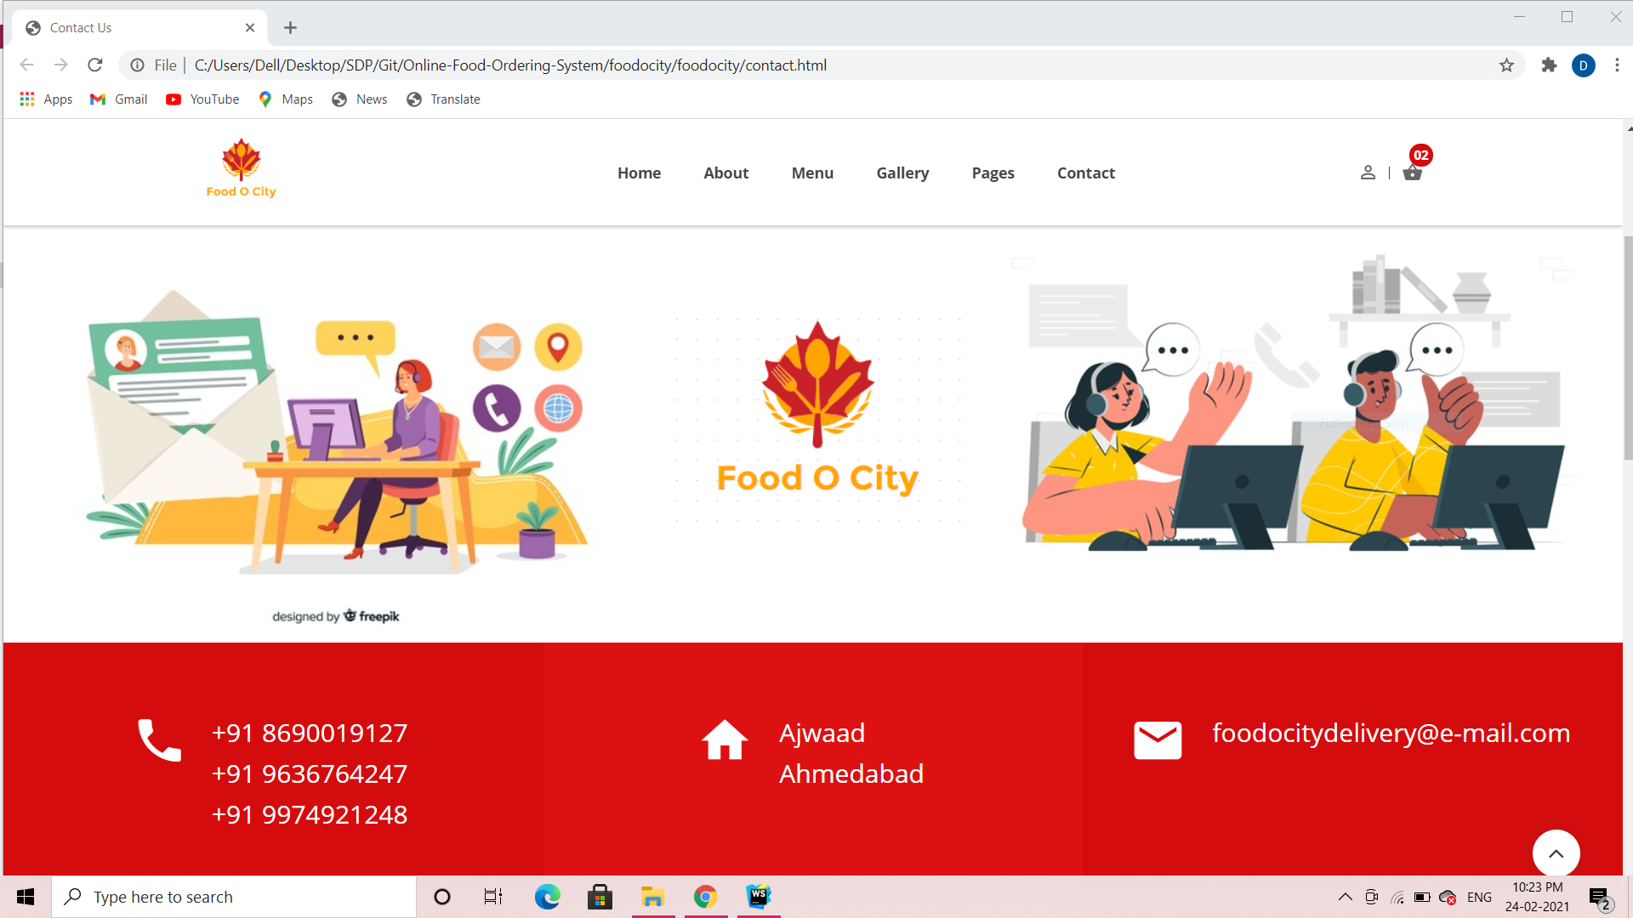
Contact Us Page 2

Slide 49
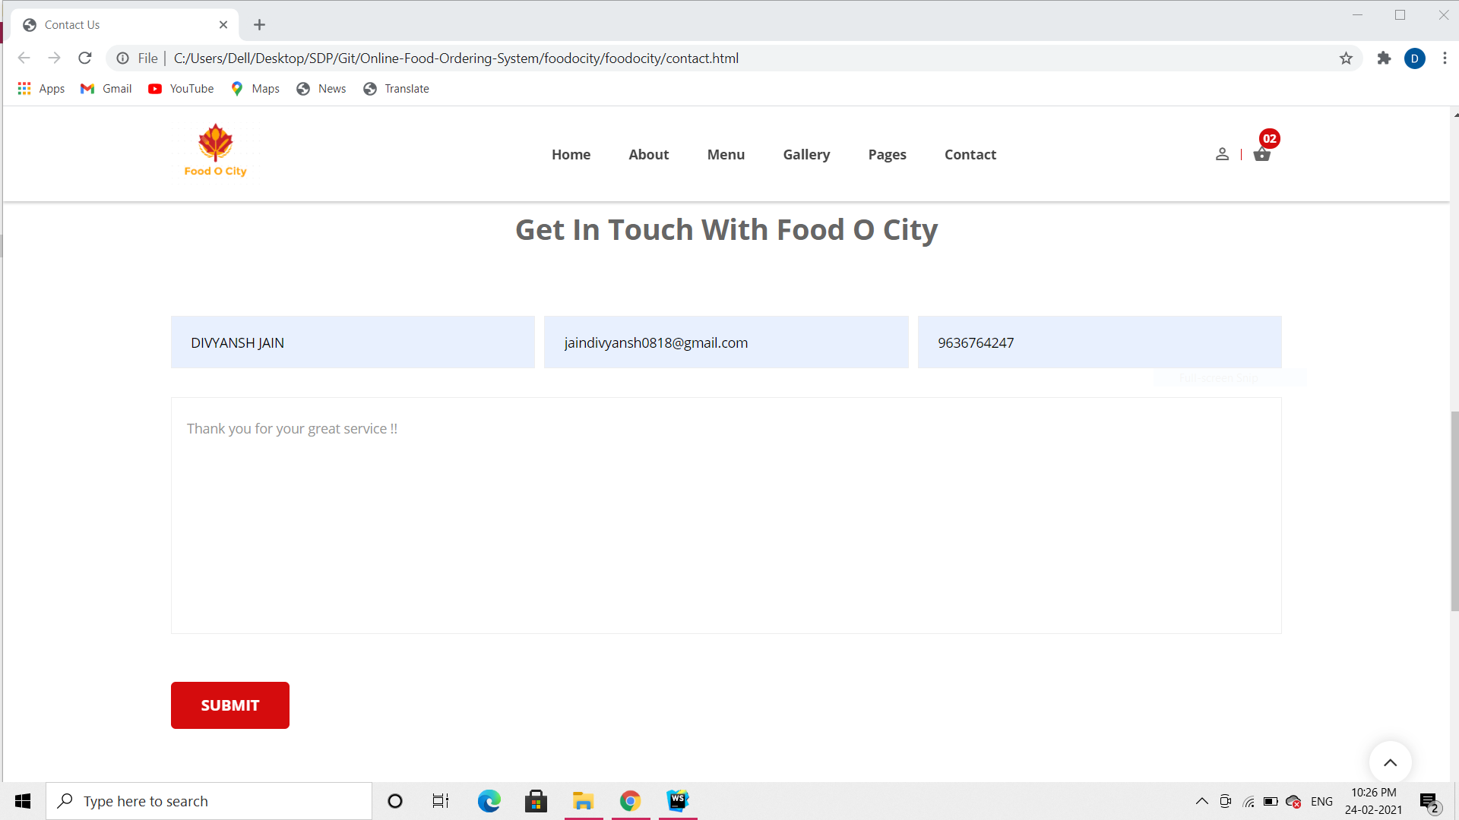
Contact Us Page 3

Slide 50
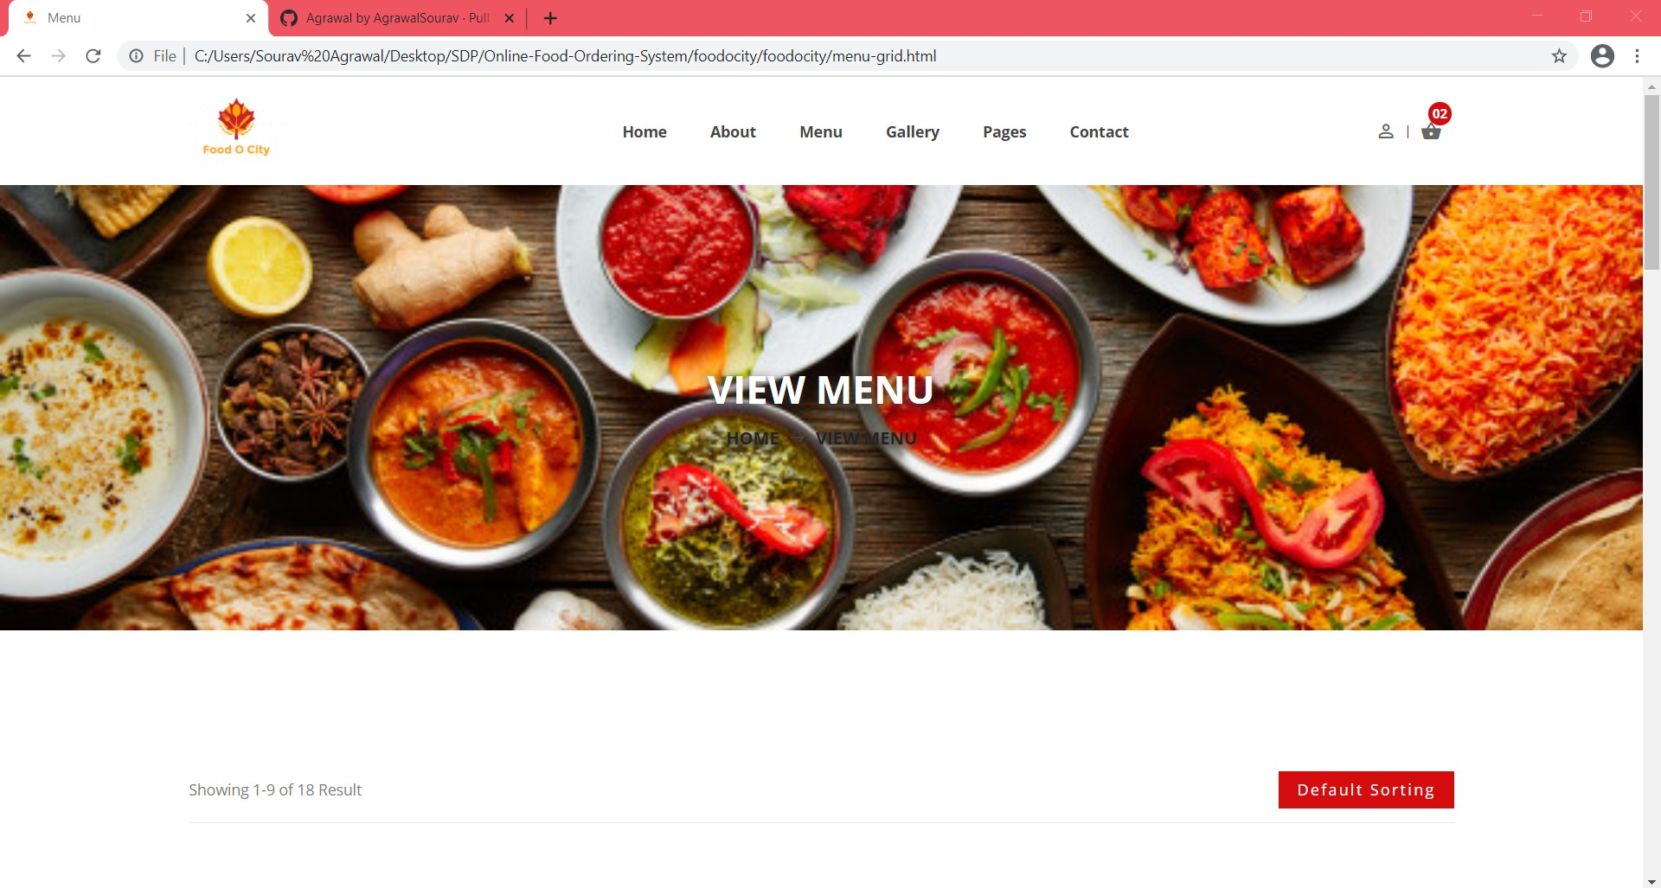
Menu Page 1

Slide 51
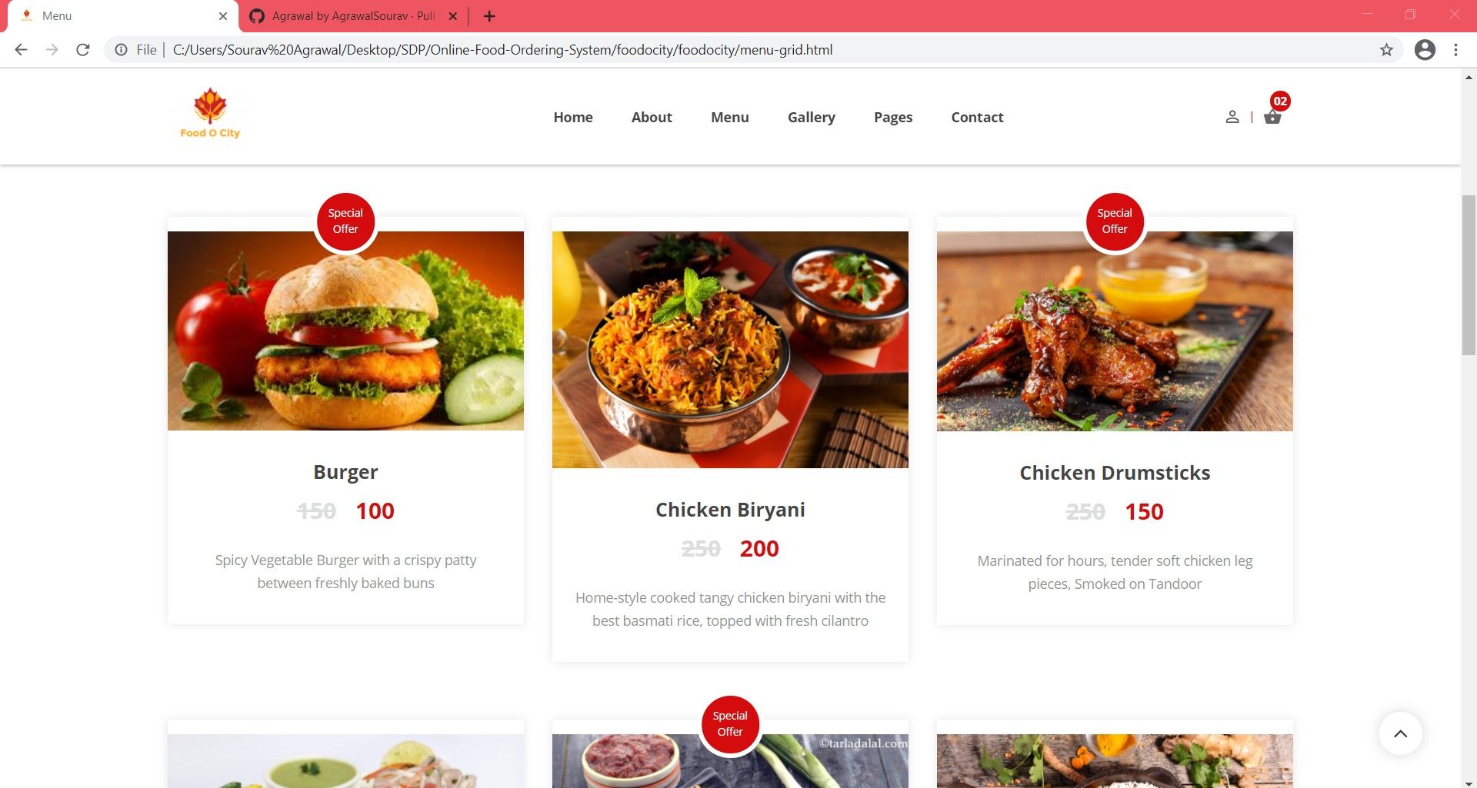
Menu Page 2

Slide 52
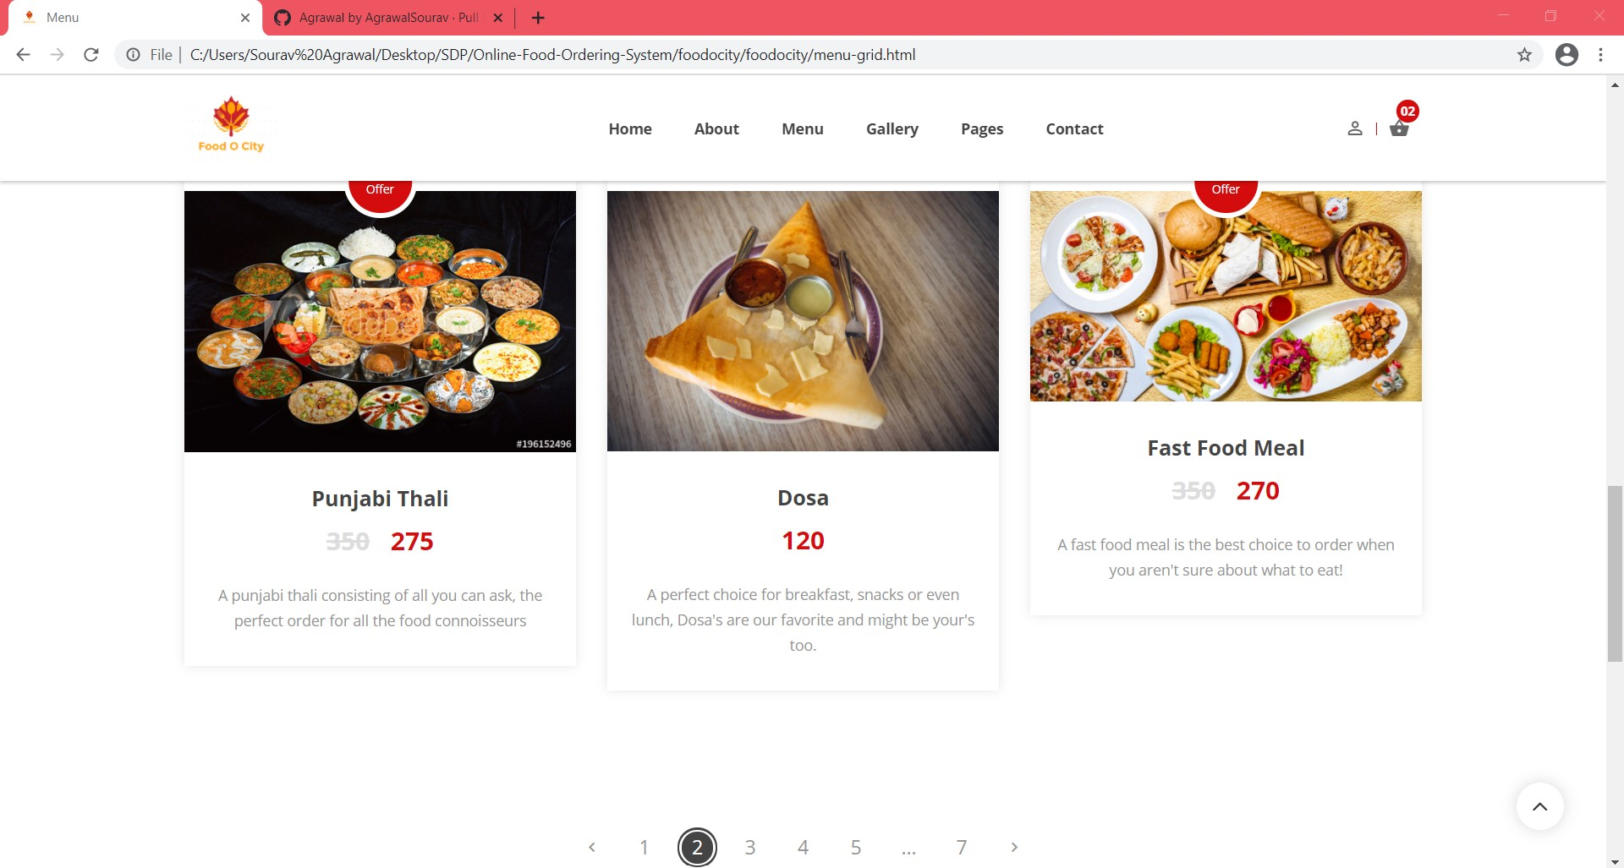
Menu Page 3

Slide 53
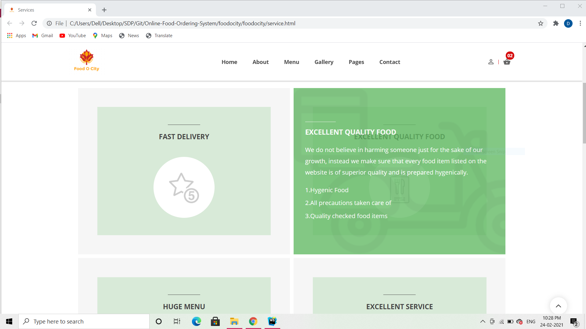
Services Page 1

Slide 54
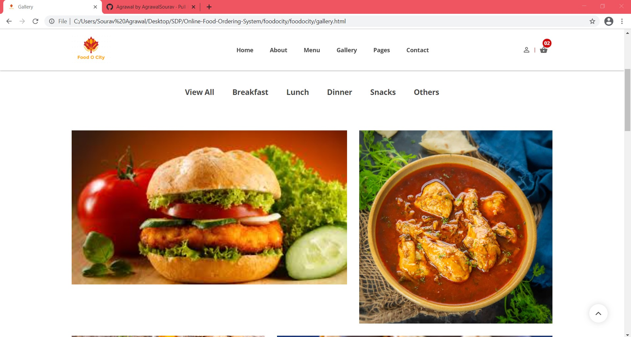
Gallery Page 1

Slide 55
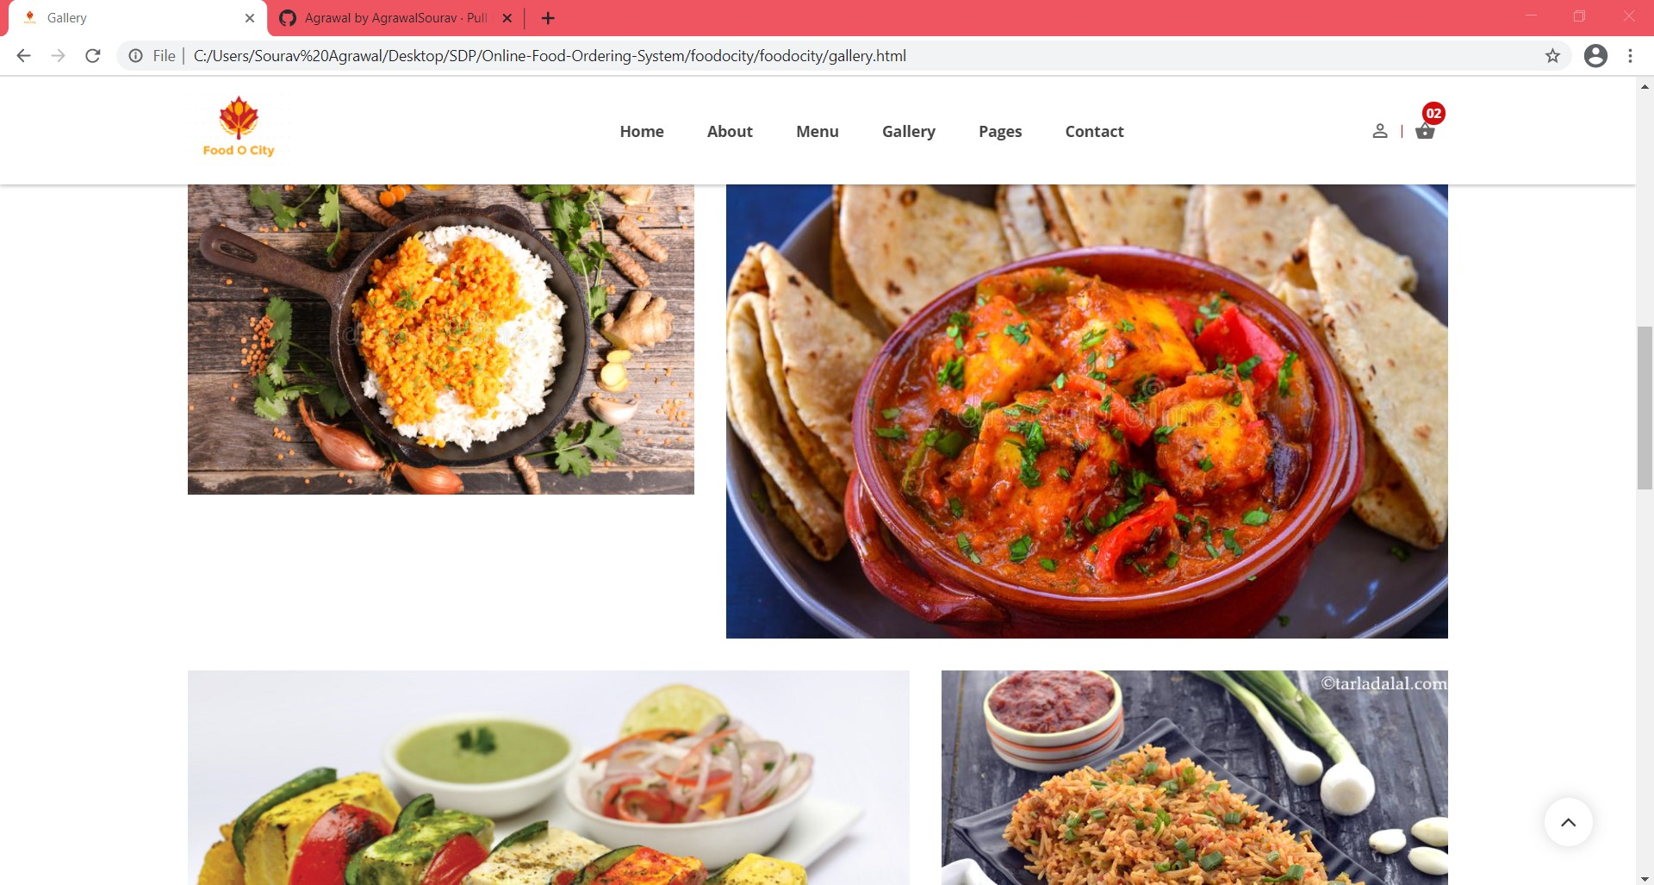
Gallery Page 2

Slide 56
Database Screenshots

Slide 57
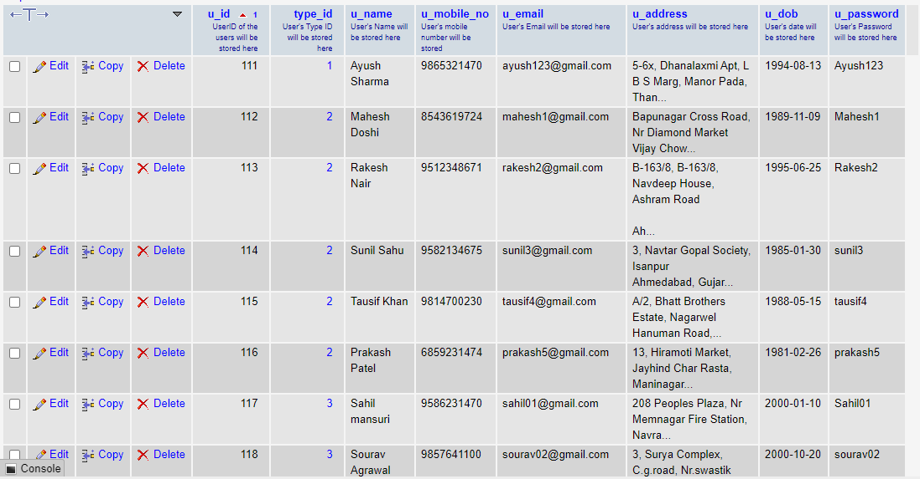
User Table

Slide 58
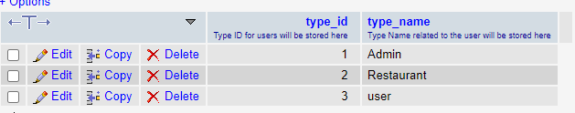
User Type Table

Slide 59
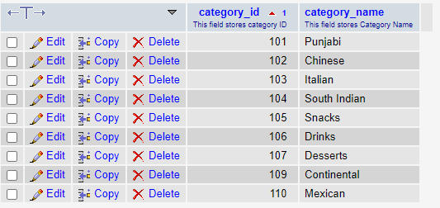
Category Table

Slide 60
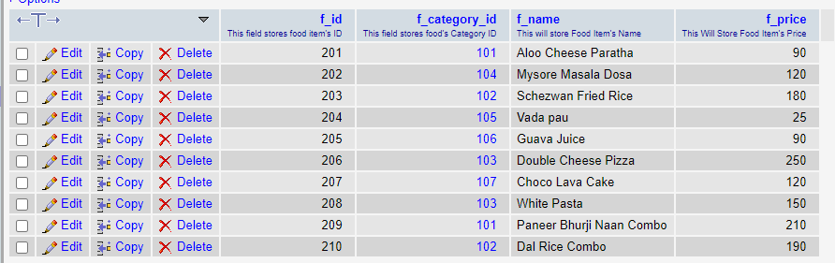
Food Items Table

Slide 61
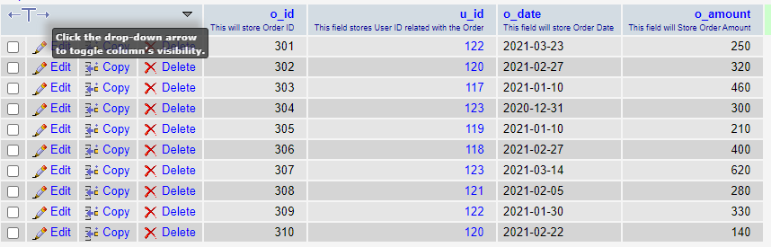
Order Master Table

Slide 62

Order Details Table

Slide 63

Payments Table

Slide 64

Delivery Table

Slide 65

Feedbacks Table

Slide 66
Reports

Slide 67

Reports For Feedback Table

Slide 68

Reports For Feedback Table

Slide 69

Reports For Feedback Table

Slide 70

Reports For Feedback Table

Slide 71

Reports For Payment Table

Slide 72

Reports For Payment Table- filtered according to Payment Mode

Slide 73

Reports For Payment Table- filtered according to User Name

Slide 74

Reports For Payment Table- filtered according to User Mobile Number

Slide 75

Reports For Delivery Table – Filtered between two dates

Slide 76

Reports For Delivery Table

Slide 77

Reports For Delivery Table – filtered by User Name

Slide 78

Reports For Food Items Table

Slide 79

Reports For Food Items Table – filtered by Category Name

Slide 80

Reports For Food Items Table – filtered by Category Name

Slide 81

Reports For Food Items Table

Slide 82

Reports For Food Items Table – filtered according to Category Name

Slide 83

Printing Reports For Food Items Table

Slide 84

Reports For Order Table

Slide 85

Reports For Order Table

Slide 86

Reports For Order Table - filtered by User Name

Slide 87

Reports For Order Table - filtered by Order Amount

Slide 88

Reports For Order Table - filtered by Food Item

Slide 89

Reports For Order Table - filtered by Payment Mode

Slide 90
Thank You

